Slide 1
Probe Station Quick Start
E. Bawolek
January 12, 2021
Revised May 6, 2021

Slide 2
Probe Manipulator & Controls
Raise / Lower Needle
In-Out Along Axis
Vacuum Release
(Push to relocate base)
Side-to-Side ⊥ to Axis

Slide 3
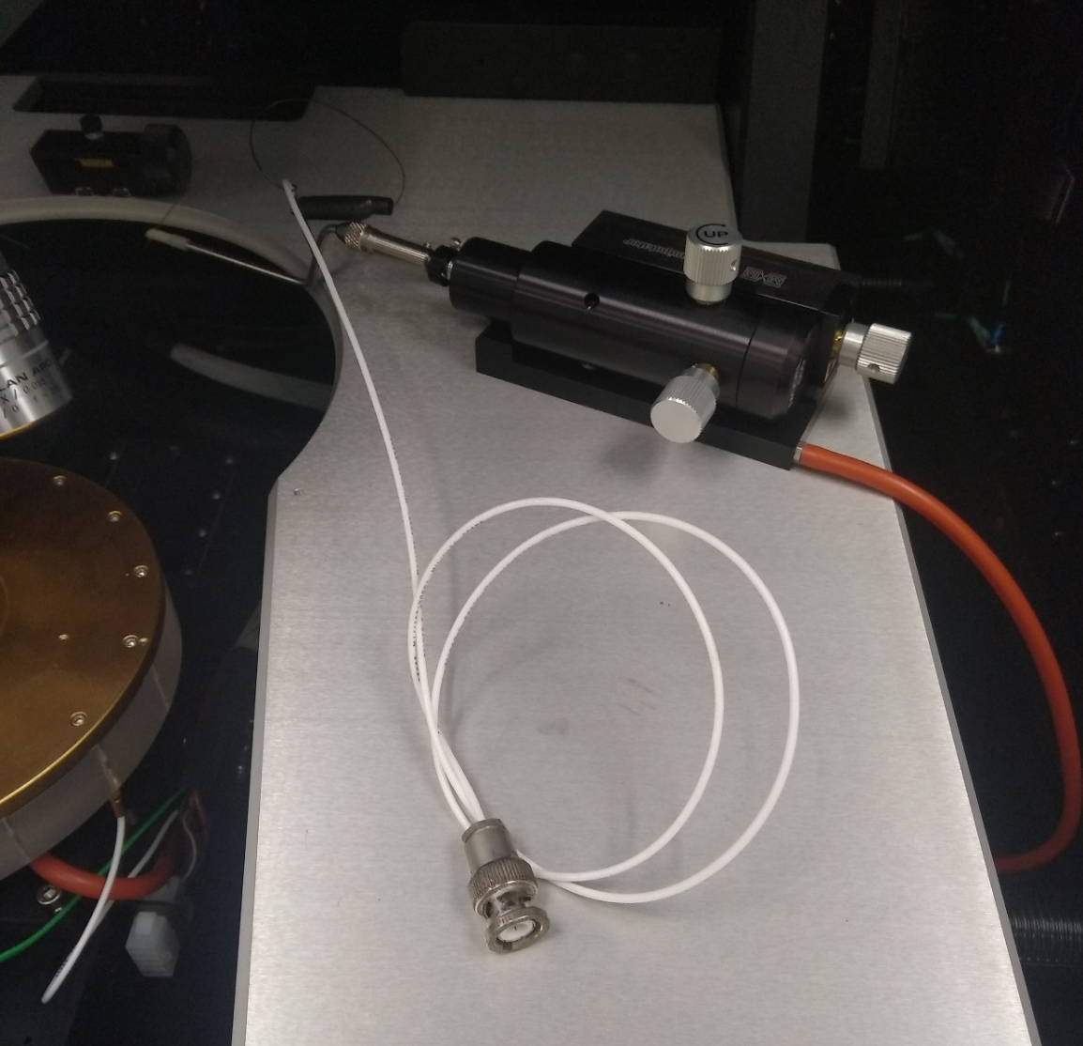
Coaxial Probe
GROUND
DUT

Slide 4
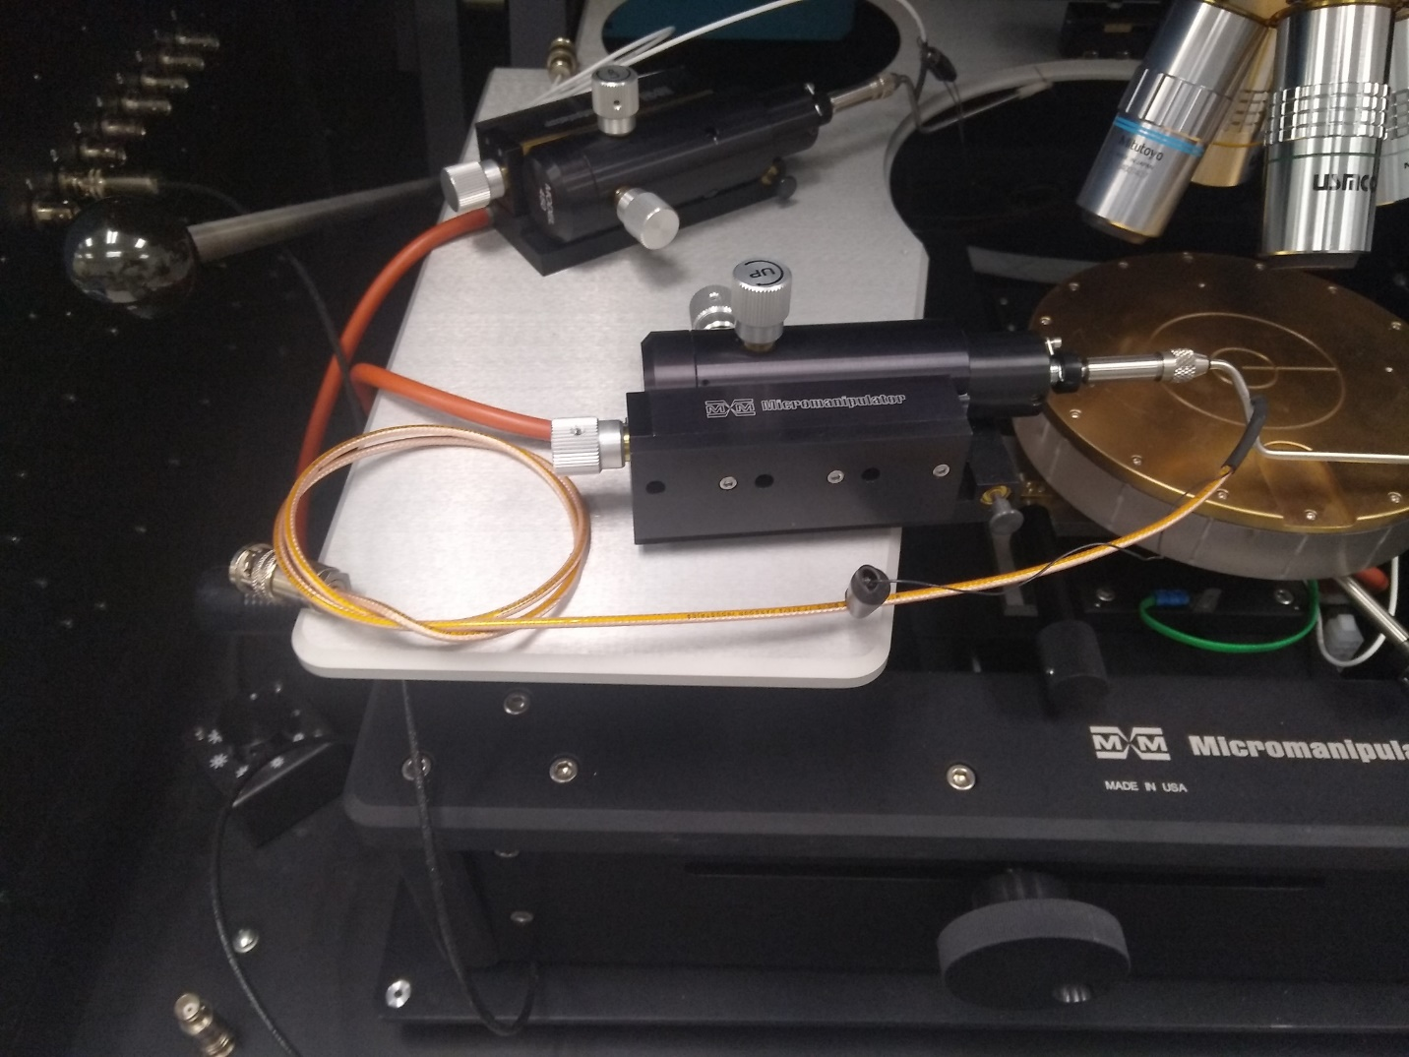
Triaxial Probe
GROUND
GUARD
DUT

Slide 5
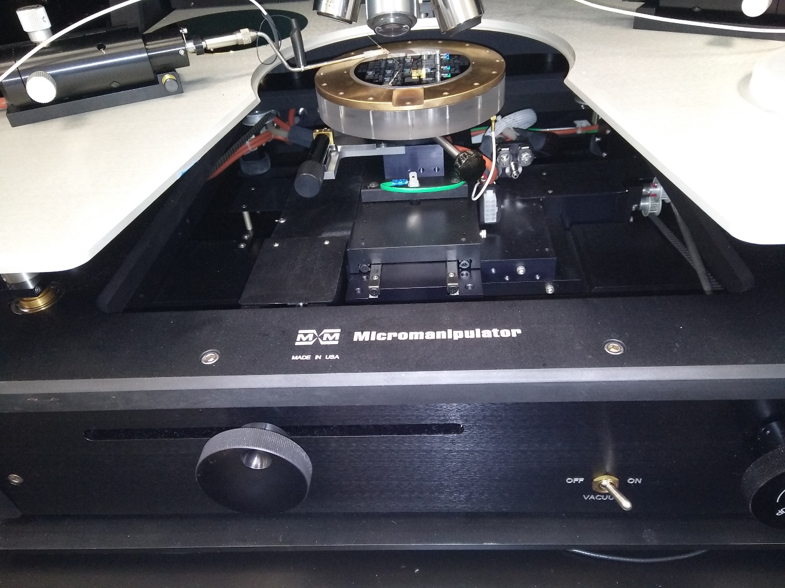
Probe Station Controls (1)
Chuck Rotation
Grounded Chuck
(Backside contact capability)
Chuck Vacuum Control
Chuck Y-Motion

Slide 6
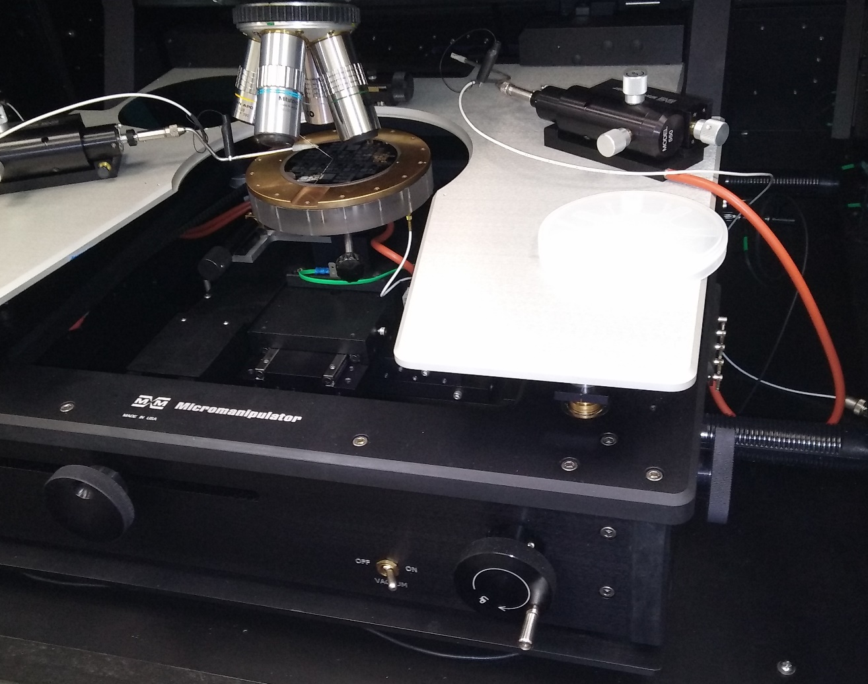
Probe Station Controls (2)
Chuck X-Motion
Platen Up/Dn
(Minimal use for single probe
test)

Slide 7
Interior Bulkhead Connectors (1)
Coaxial Pass-thru
Triaxial Pass-thru
1-4: Triaxial Connectors
5-8: BNC Connectors

Slide 8
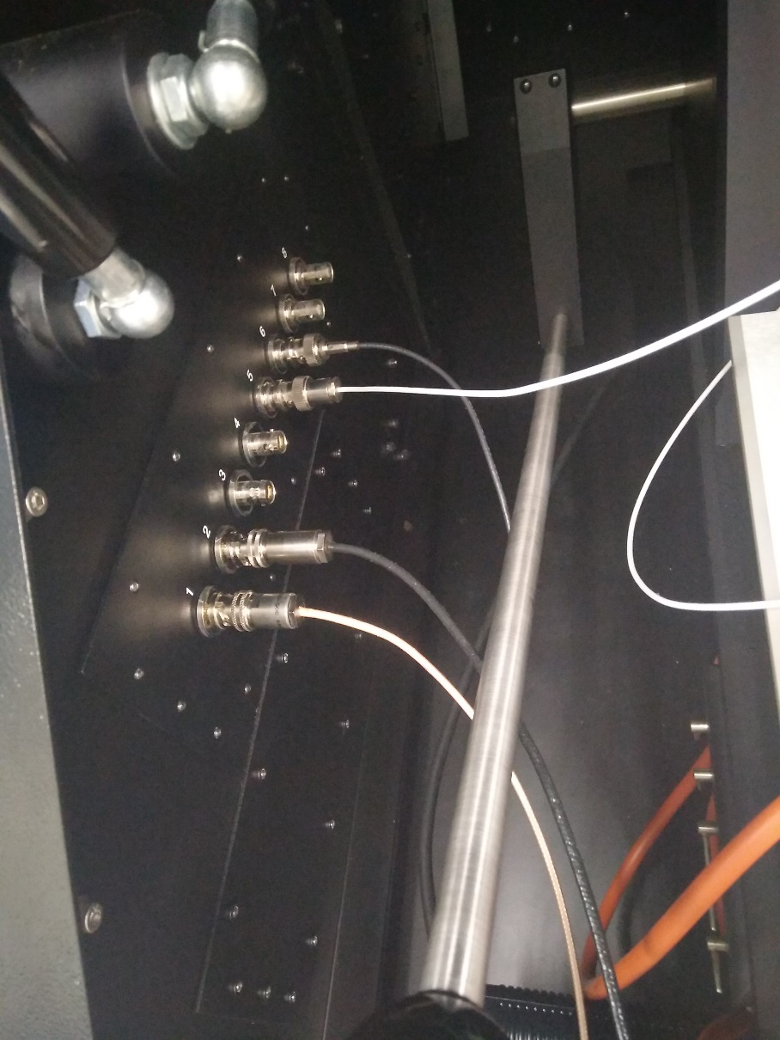
Interior Bulkhead Connectors (2): Recommended Configuration
Coaxial Connection for C-V Sweeps
Chuck Ground:
Coax for C-V sweeps and Keithley 237 I-V
Triax for I-V sweep with Keitley 4200SCS
Be sure to connect appropriate cable at chuck connection on right side of the probe station!
Triaxial Connection for I-V sweeps
1-4: Triaxial Connectors
5-8: BNC Connectors

Slide 9
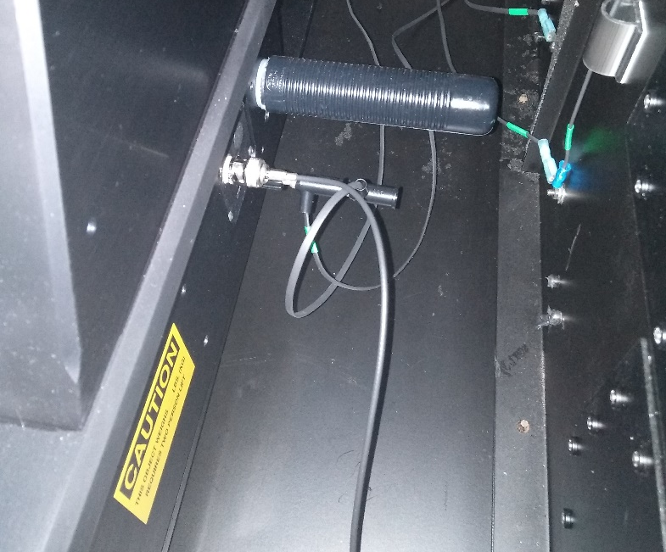
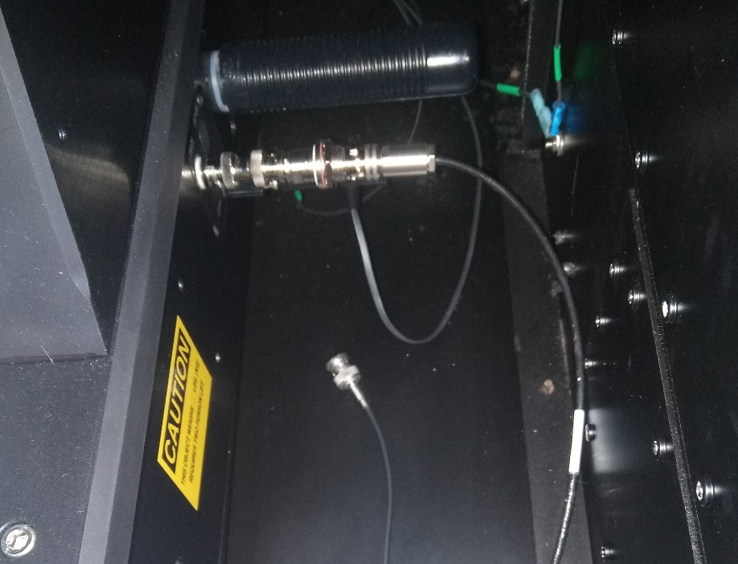
Two types of chuck ground connections:
Triaxial adapters and triaxial cable. Use for current-voltage testing with Keithley SCS4200.
Coax connection, use for
capacitance testing and for current-voltage testing with the Keithley_237

Slide 10
Our Typical Configuration Outside Bulkhead #1: Keithley 237 SMU
This is how we typically configure the probe station connections
You may set up differently according to your needs and preference
Remember: Other users may change things around
Trace the wiring!
Check your connections!
OUTPUT LO (Coax)
OUTPUT HI (Triax)
Keithley 237

Slide 11
Our Typical Configuration Outside Bulkhead #2: HP4284A
This is how we typically configure the probe station connections
You may set up differently according to your needs and preference
Remember: Other users may change things around
Trace the wiring!
Check your connections!
LCUR/LPOT (Coax)
HCUR/HPOT (Coax)
HP4284A

Slide 12
Our Typical Configuration Outside Bulkhead #3: Keithley 4200SCS
This is how we typically configure the probe station connections
You may set up differently according to your needs and preference
Remember: Other users may change things around
Trace the wiring!
Check your connections!
GND (Triax)
SMU1 (Triax)
Keithley 4200SCS

Slide 13
Microscope Illuminator Control
Located on the bottom left side of the dark box interior

Slide 14
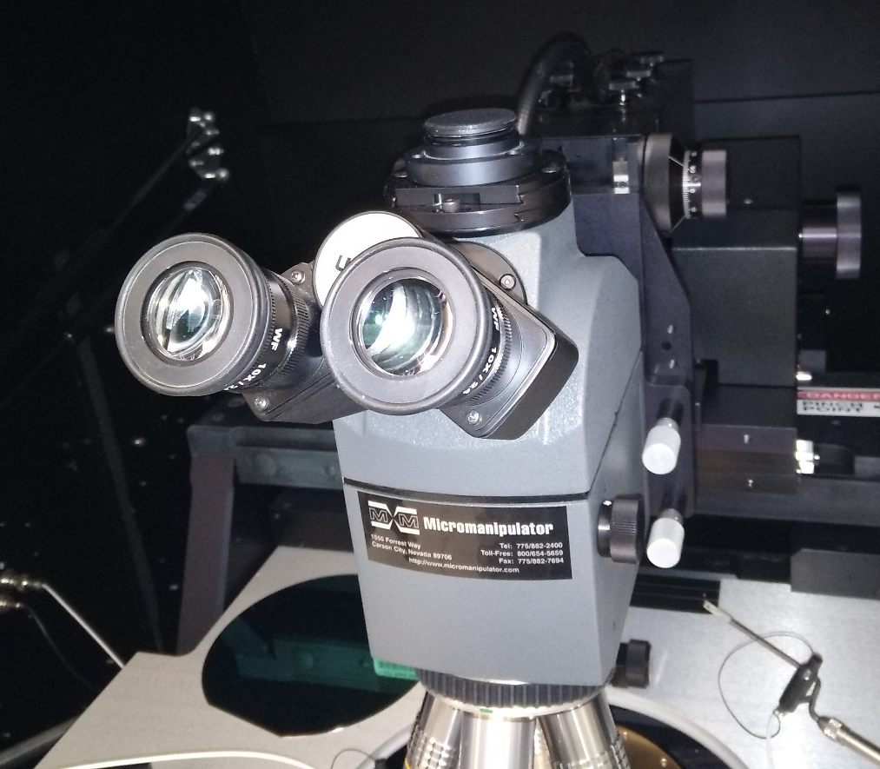
Microscope Head
Focus Adjustment
Objective Turret Ring
(Grab here to change objectives)

Slide 15
Pointers / Useful Info
Common errors:
Moving probe or stage without raising needle – take your time until you develop good habits
Lifting platen (lever not shown) to raise needles will likely crash probe into microscope objective ☹
Remember to engage chuck vacuum to ensure good backside contact
Remember to turn light off when testing
Probes are available with Triax or BNC cables
Triax used for very low current measurements
Probably not as useful when using a backside contact
If you do not understand the electrical differences and the uses of coax vs. triax cables, it will be well worth the investment of time to study them!!

Slide 16
Troubleshooting - General
The probe station and connected instruments are used by multiple groups. They are probably not in the same configuration as you left them last time.
CHECK YOUR CONNECTIONS!
The chuck (ground connection) has two possible cables – triax and coax.
The cable to be used depends upon the test.
A common mistake is failing to connect the “other” cable.
Danger! – The triax ground cable will not work with the Keithley 237 SMU. Check with Ed/Jovan on this or consult the operating manual connection schematic.

Slide 17
Troubleshooting – HP Capacitance Meter
The setup and successful operation of this meter is more involved than a simple current – voltage measurement, so it is important to read the manual.
Be sure that the meter is set to your desired operating conditions:
Test frequency
Signal Level (low frequency tests may benefit from higher signal voltage)
Test function (Cs-Rs, Cp-D, etc.)
Secondary settings (Averaging, integration time, correction factors, ALC,… read the manual)
If the instrument is not responding to the control computer, power cycle the instrument / reboot the computer.
A test capacitor can verify instrument functionality
You will have to change the instrument triggering from BUS to INT for a real-time display
You will also need to put the instrument into Local mode

Slide 18
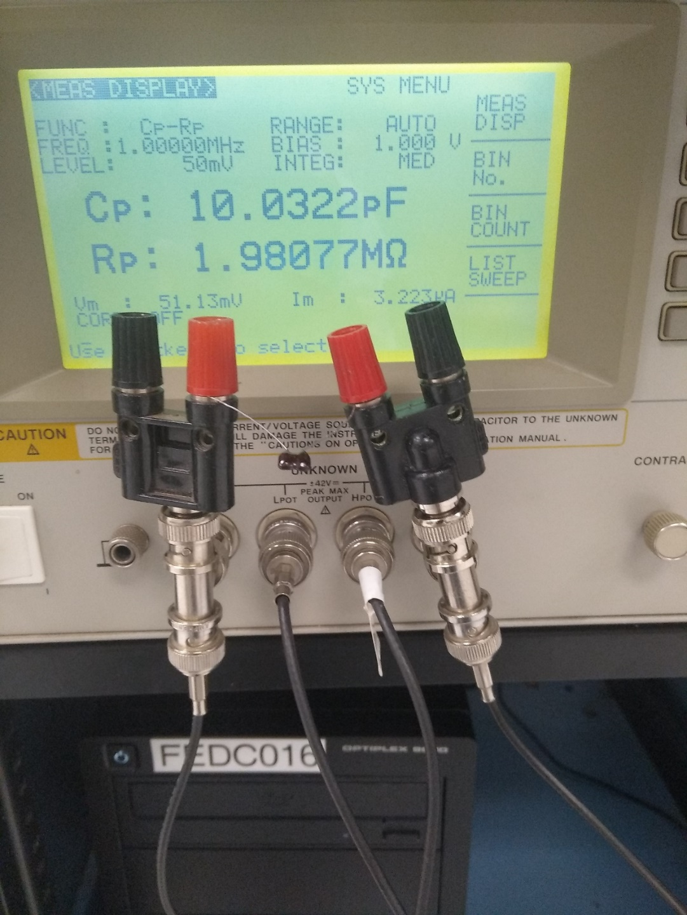
Test Capacitor: HP4284A
A test capacitor connected to the instrument inputs can provide a quick check to ensure everything is functioning correctly. If the meter was being operated from the computer via Labview, it will be necessary to place the meter in Local mode, and to set the triggering to Internal.
This setup can also be useful if you want to explore the control panel functions with a known device attached to verify proper operation.

Slide 19
Test Capacitor Inside Dark Box
Here we placed the test capacitor inside the dark box attached to the bulkhead connections going to the HP4284A LCR meter. With this configuration you can test not only the meter, but also the cables leading to the dark box.
Test Capacitor

