Slide 1
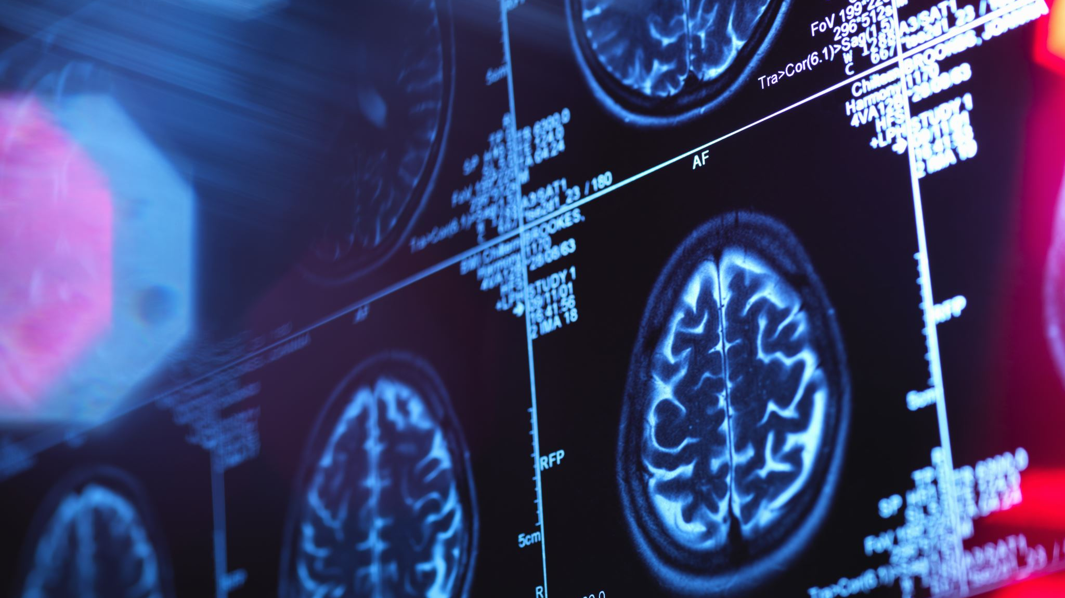
Preclinical Imaging: MRI Basic Safety Training

Slide 2
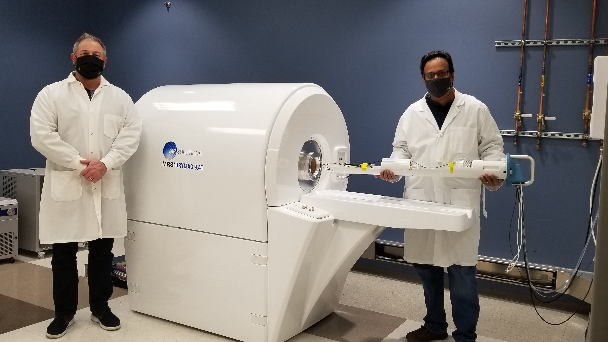
MRI Introduction
MRIs are an imaging technique that uses magnetic fields, gradients, and radio waves to take pictures of the anatomy and physiological processes inside the body.
MRIs are noninvasive and radiation-free!
Used as diagnostic and research tools.

Slide 3
Personnel Safety
Because MRIs use powerful magnets, it is important to be:
Medically safe
Medically cleared by a trained operator
Physically safe
Remove all items on person
Place all items in designated bins
Vigilant to keep others safe
Understand risks and watch out for others

Slide 4
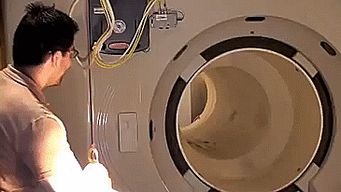
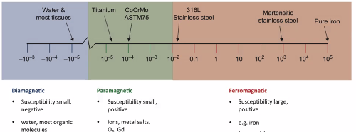
Metals
Ferrous/Ferromagnetic: Iron, steel, some stainless steel, nickel
Are attracted to the magnet
Paramagnetic: Gold, silver, platinum, titanium, aluminum, copper, brass, and lead
Can have induced magnetic forces
General Rule: Keep Metal Items Out!

Slide 5
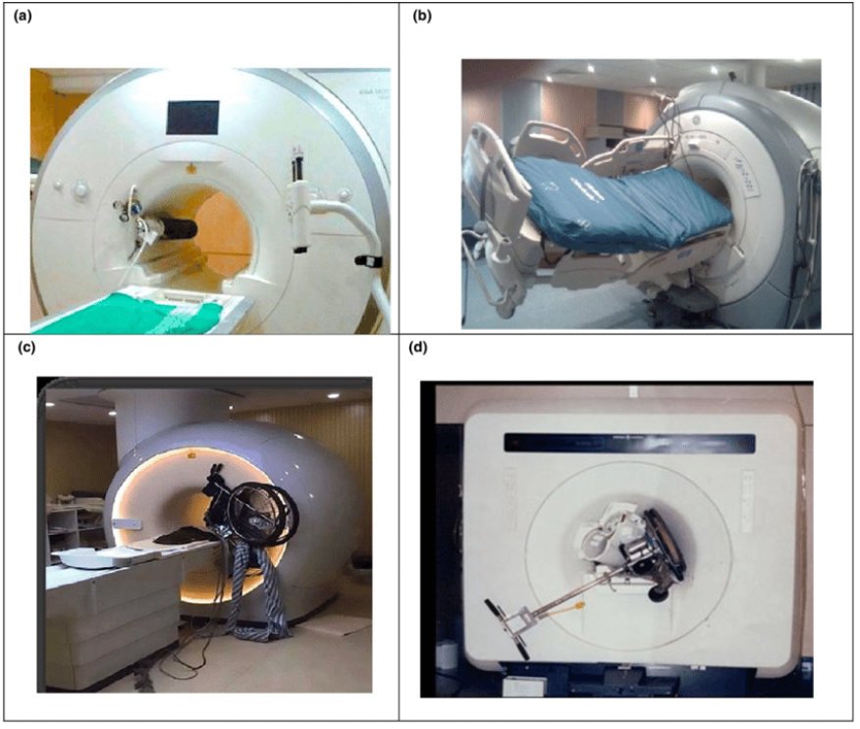
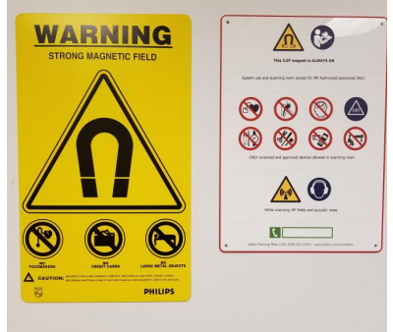
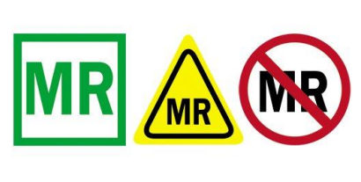
Equipment Safety
New items must be cleared by trained staff before bringing into the Magnet Room
Prevent any unknown items from entering the Magnet Room!
REMEMBER: The MRI IS ALWAYS ON!

Slide 6
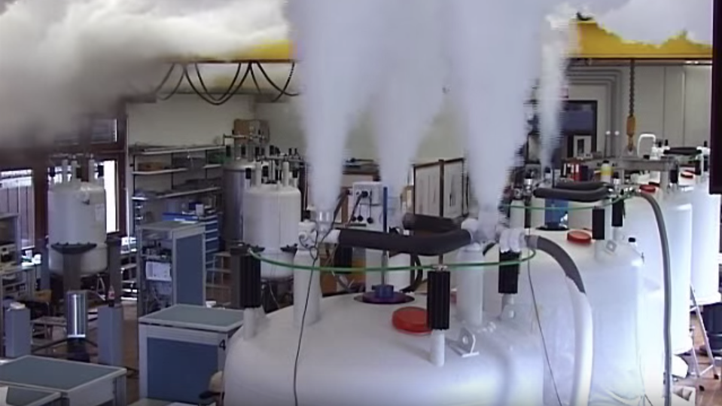
Facility Hazards To Be Aware Of
Preclinical Imaging and NMR share the same space
Magnetic Field Hazards
Always ON!
There are barrier-less magnet zones so walking outside of designated paths are unsafe
Cryogenic Hazards
Asphyxiation (nitrogen 695:1 helium 760:1)
Frostbite (nitrogen -196C helium -269C)
Chemical Explosions
Chemical Hazards
Potentially Toxic and Dangerous compounds and solvents

Slide 7
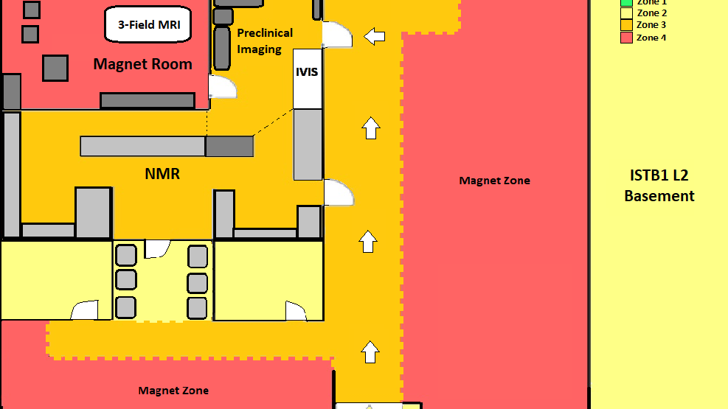
Facility Zones

Slide 8
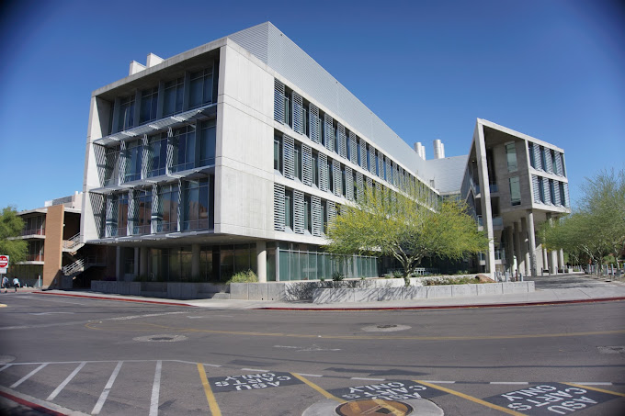
Zone 1: Public Areas
Elevators
Restrooms
ISTB1 Lobby

Slide 9
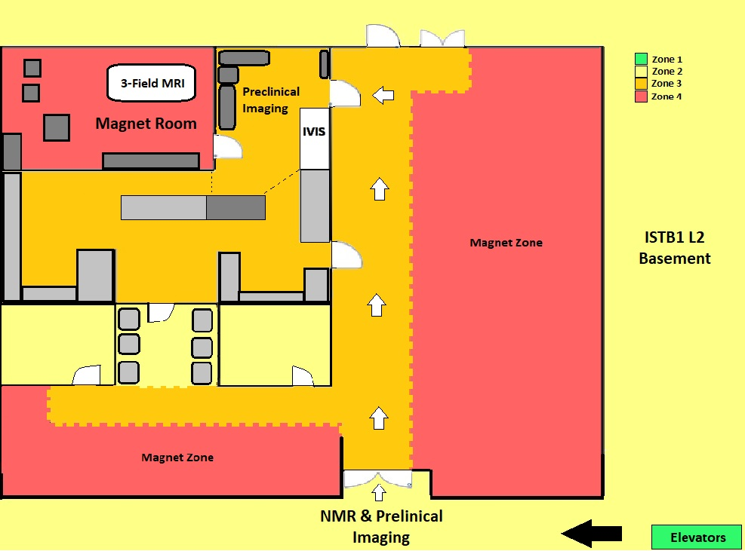
Zone 2: Low-Risk
Break area
Staff Offices
ISTB1 L2 Pathways outside of facility to and from elevators/stairwells

Slide 10
Zone 3: Trained Staff
Untrained Students/Visitors Must Have Permission from Proper Channels, Briefed On Hazards, & Screened
MR Computer & Bench Stations
Areas Just Outside Of Magnet Zones

Slide 11
Zone 4: High Risk
Magnet Zones
Restricted To Trained Staff Only
Keep belongings And Unauthorized Items Out!
Ferrous Metals Brought Here Pose A Huge Danger!

Slide 12
No Food or Drink Area

Slide 13
Important Takeaways
Safety Certification Guide:
MRI Safety Instructions
MR Medical Screening Form
Magnet Safety Test
Facility Walkthrough
The MRI Is ALWAYS ON!
Be Vigilant!
General Rule: Keep ALL Metal Items OUT!
Ferrous = Attracted To Magnet
Remove Belongings Before Entering The Magnet Room
Check New Items With Staff
Review Facility Zones
Follow Designated Paths
Be aware of the areas you enter
HAVE FUN! STAY SAFE!

