Slide 1
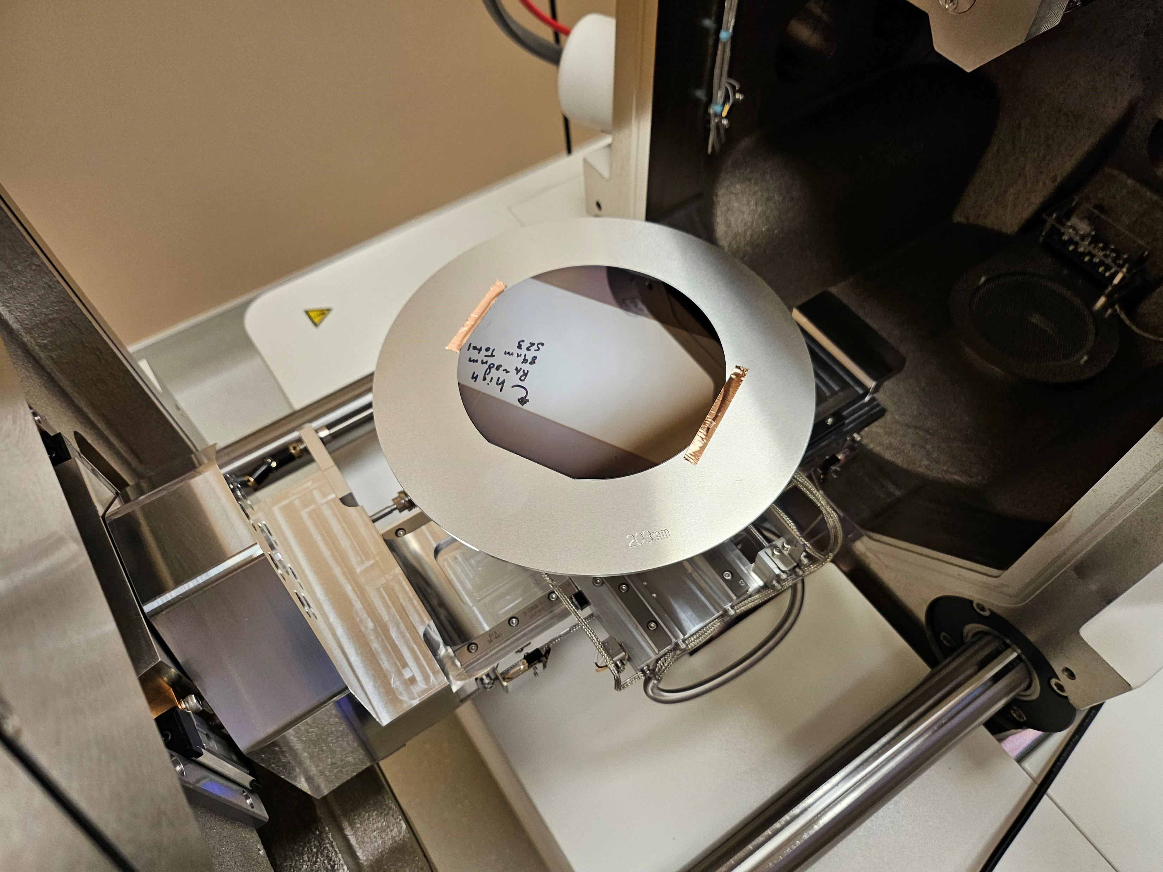
1. Loading a sample
2. Start observation
3. Move to the observation area by double-click and Zoom in with digital zoom

Slide 3
