Slide 1
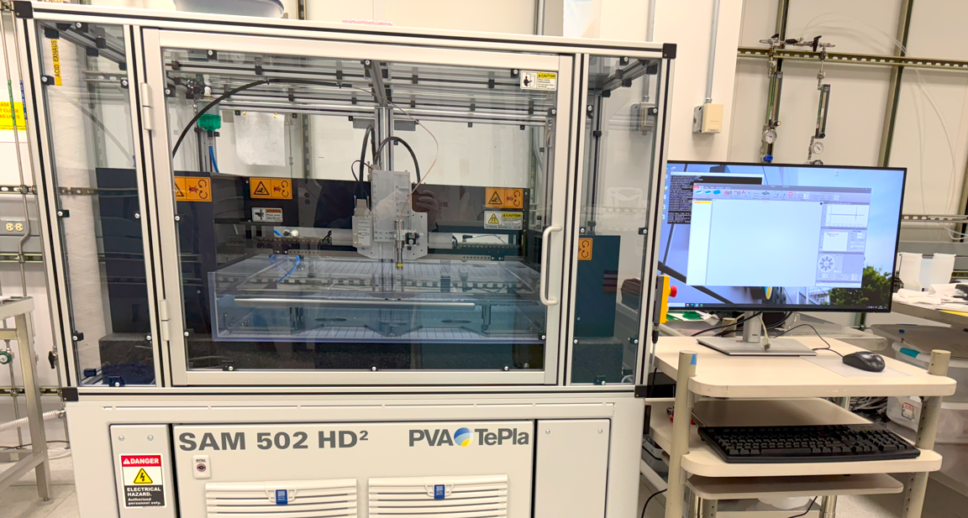

Slide 2
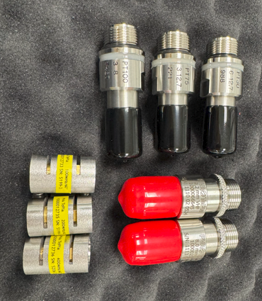
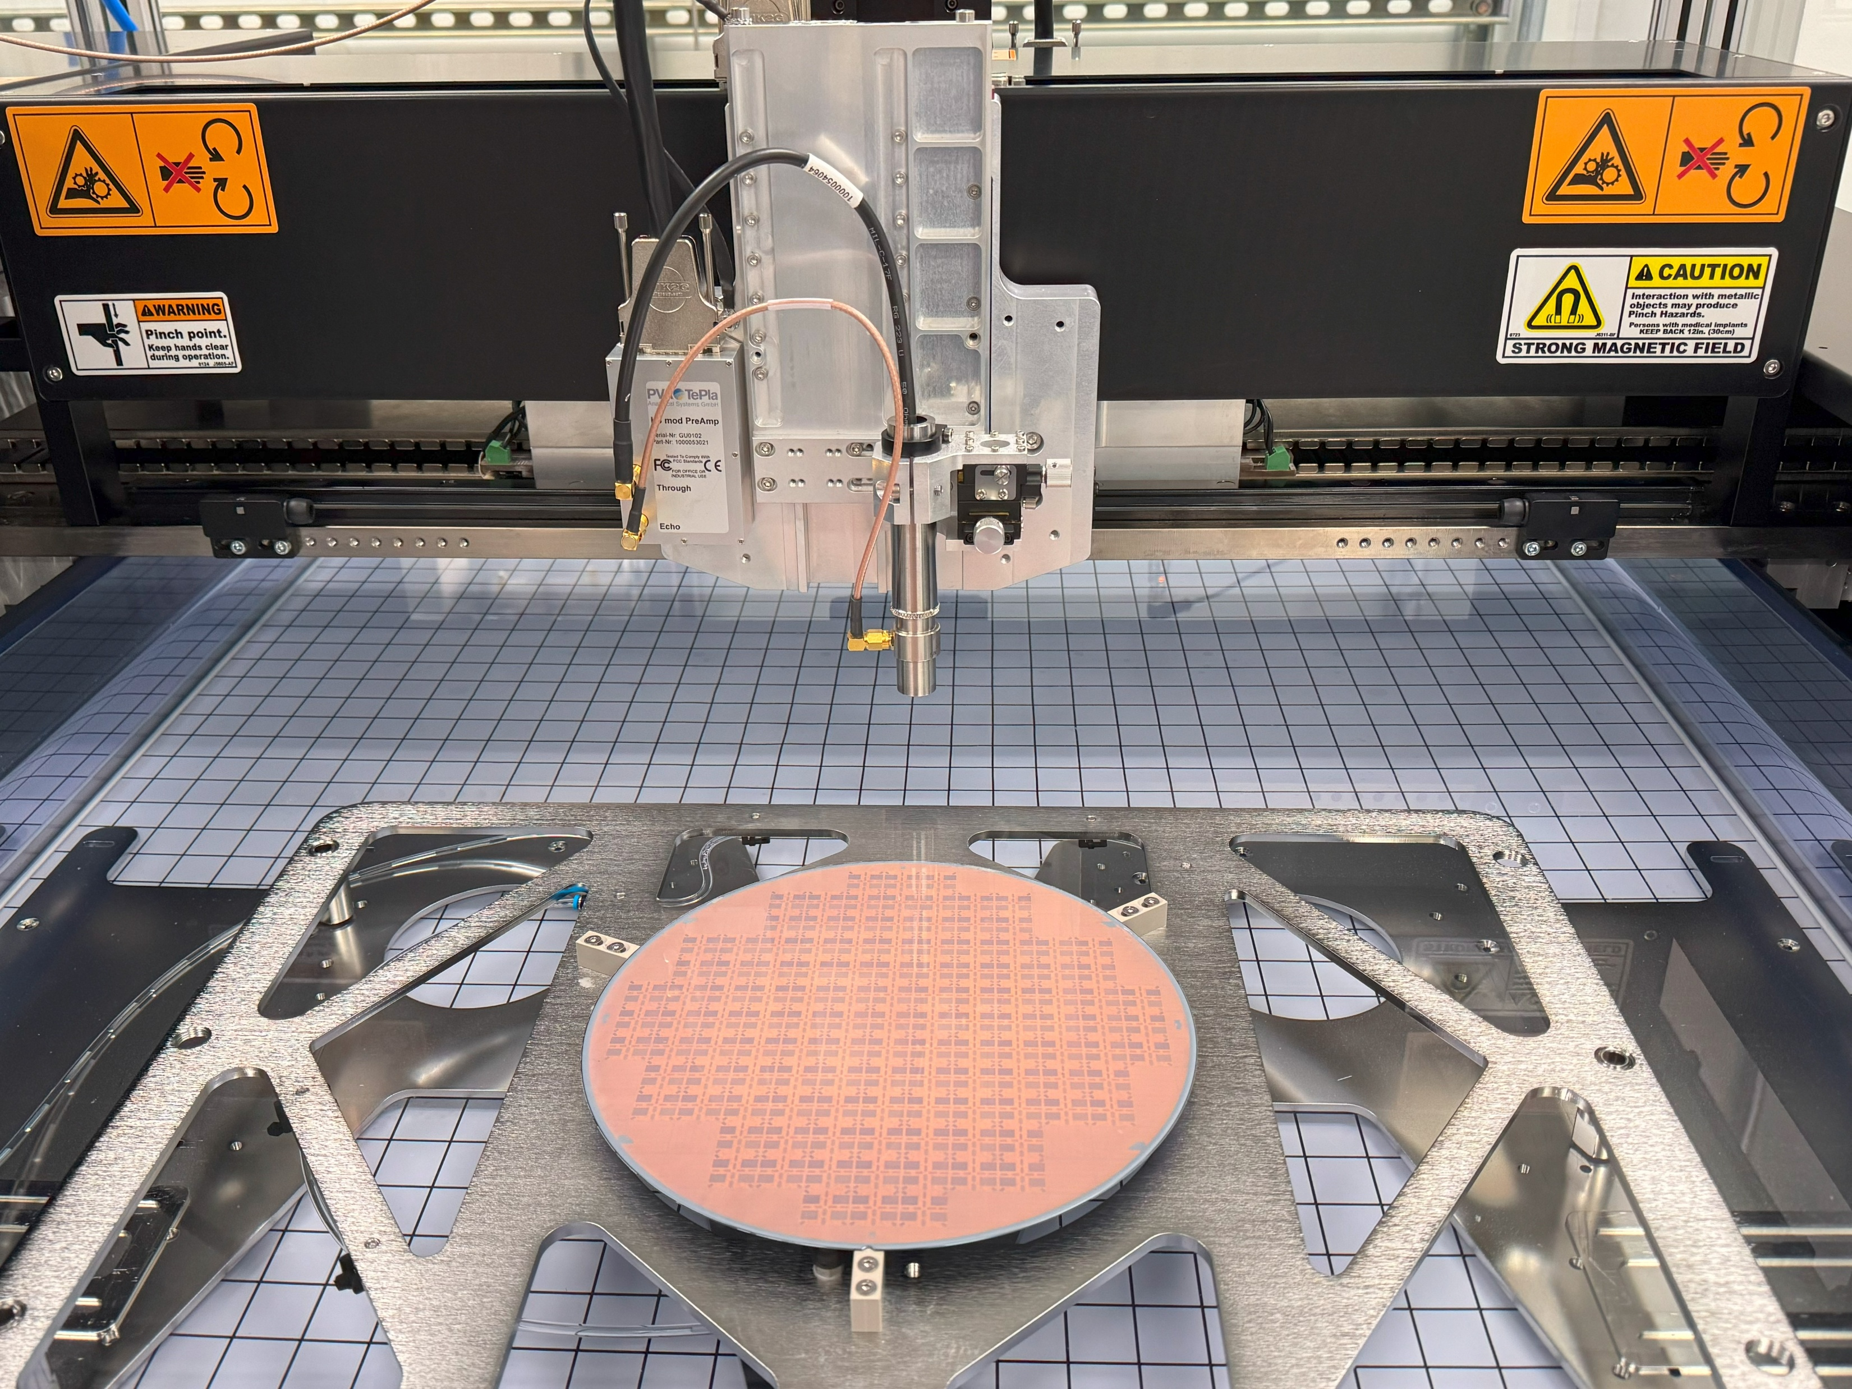
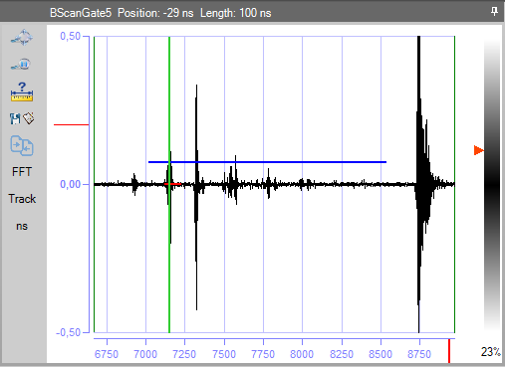
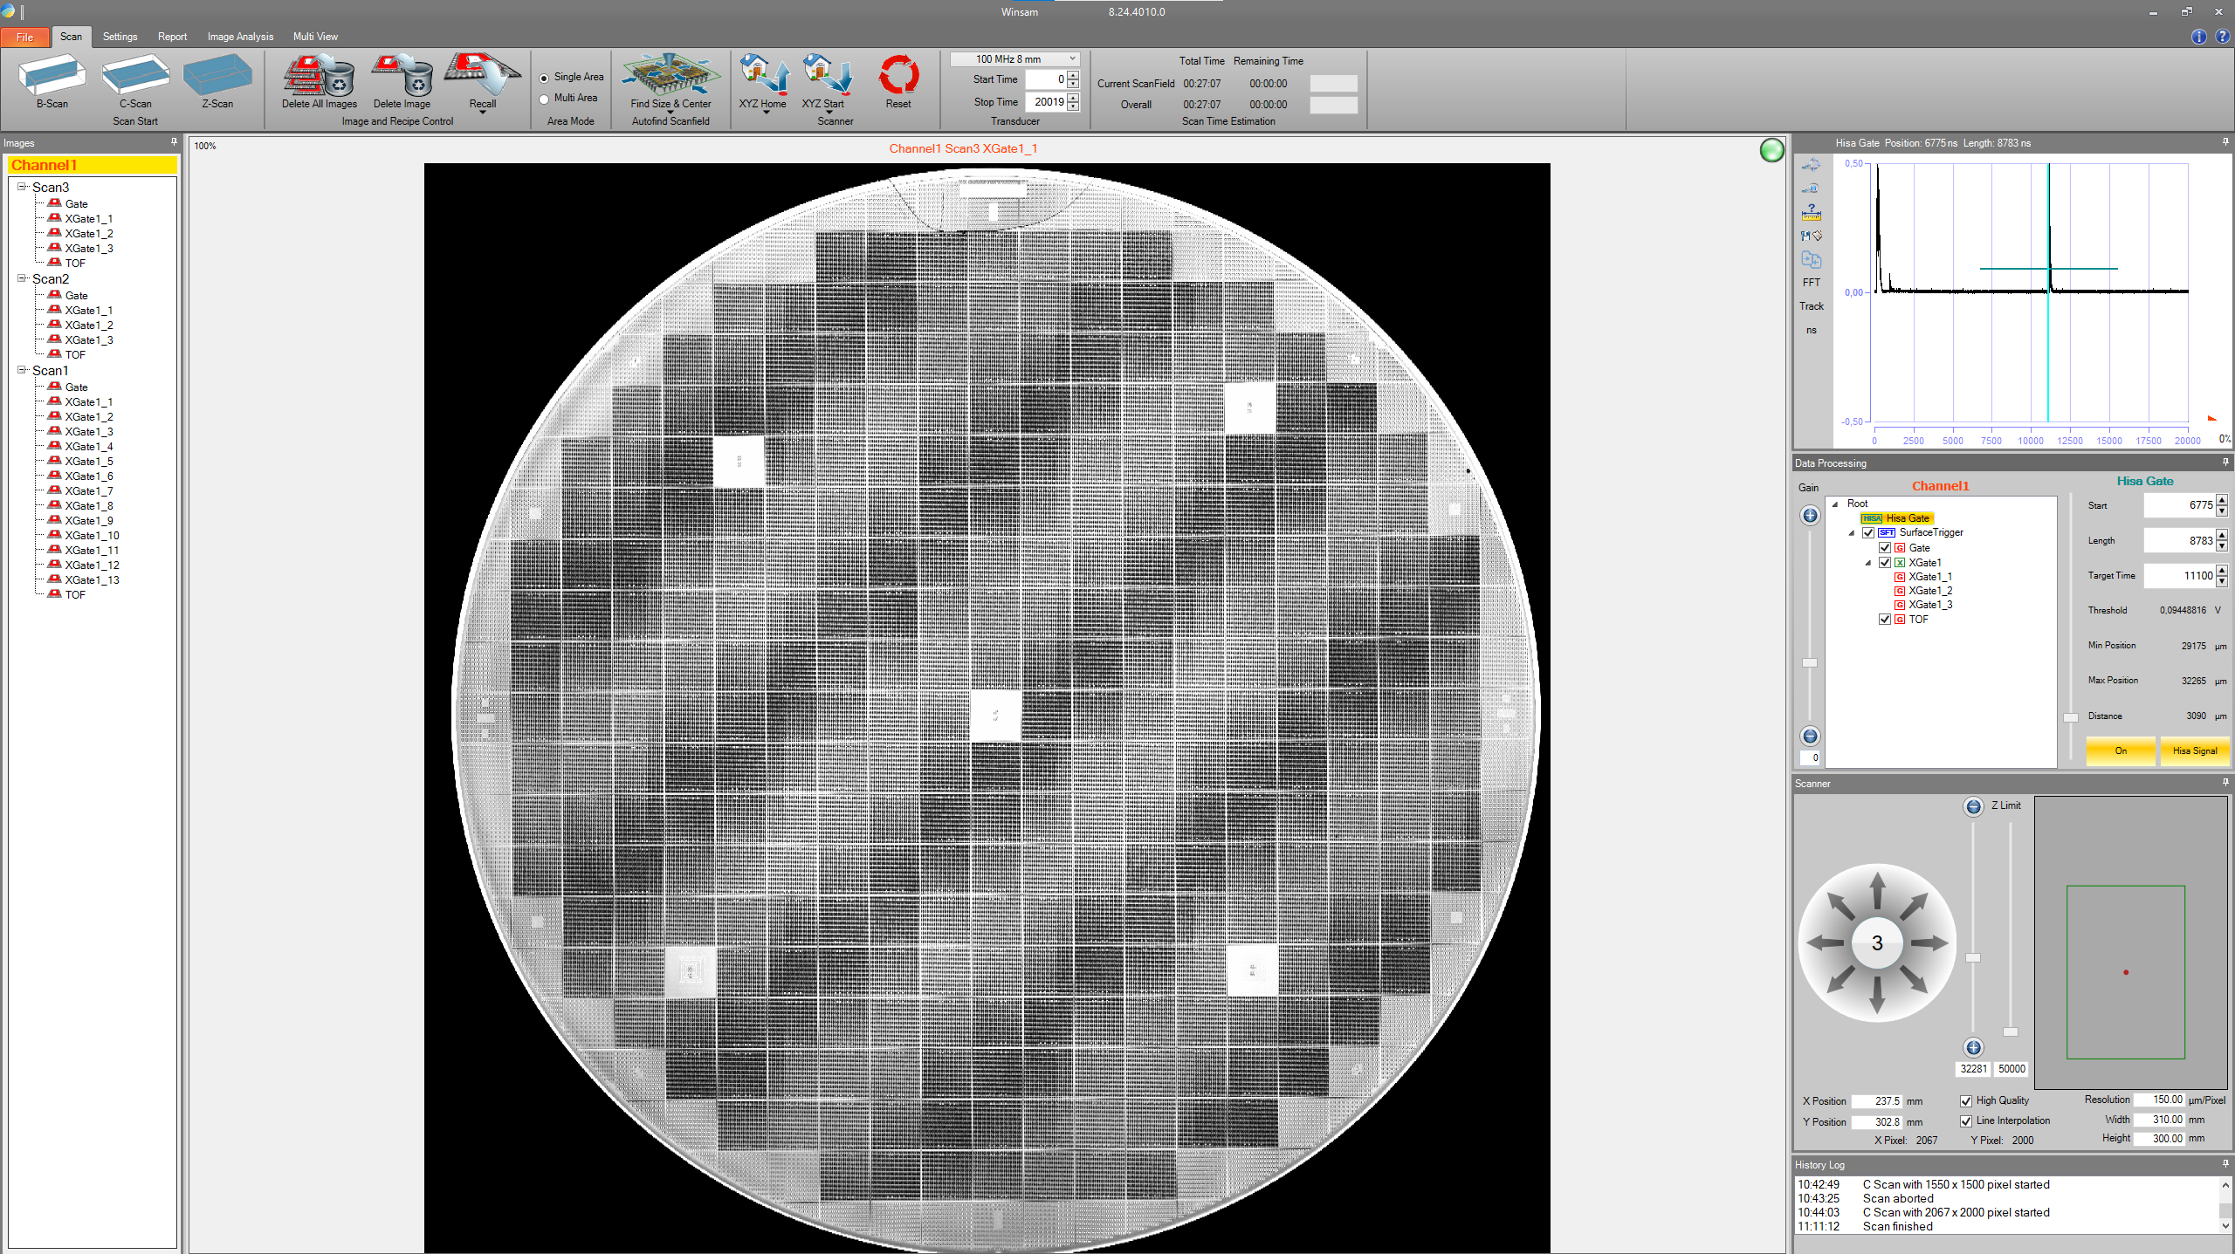
1. Select a suitable transducer
2. Mount transducer & submerge sample in deionized water
3. Select depth/interface of interest
4. Start scanning

Slide 3
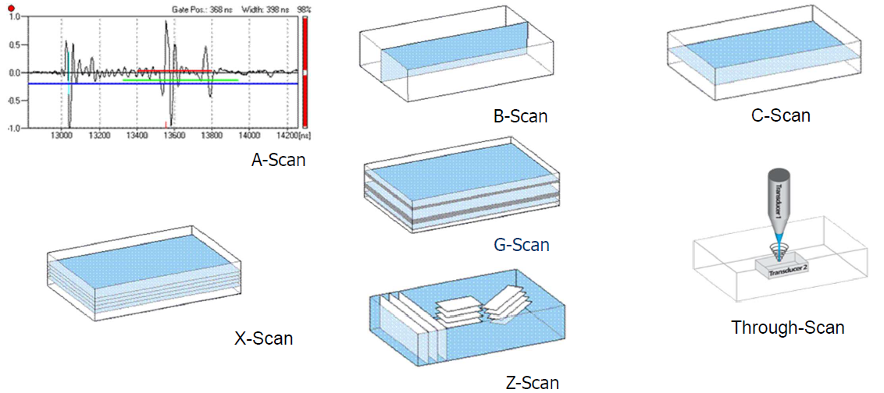
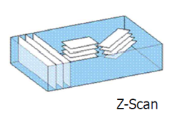
SAM Scan modes
Source - PVA TePla

Slide 4
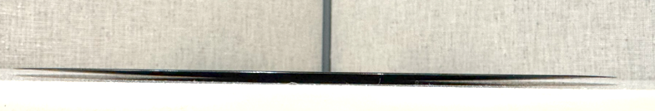
High Speed Scanning Axis (HiSA) function
Z-axis is constantly adjusting transducer height which follows surface curvature
300mm Warped wafer
HiSA off
HiSA on

