Slide 1
Kruss Goniometer
(Contact Angle)
Yong Kyun Lee
ylee64@asu.edu

Slide 2
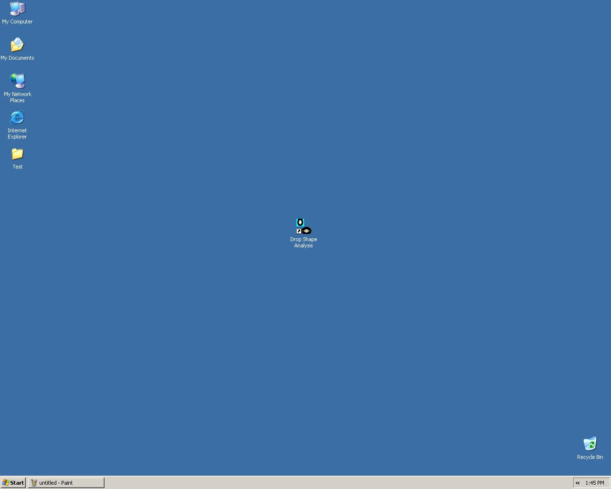
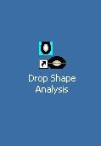
Double click “Drop Shape Analysis” icon to start the control software.

Slide 3
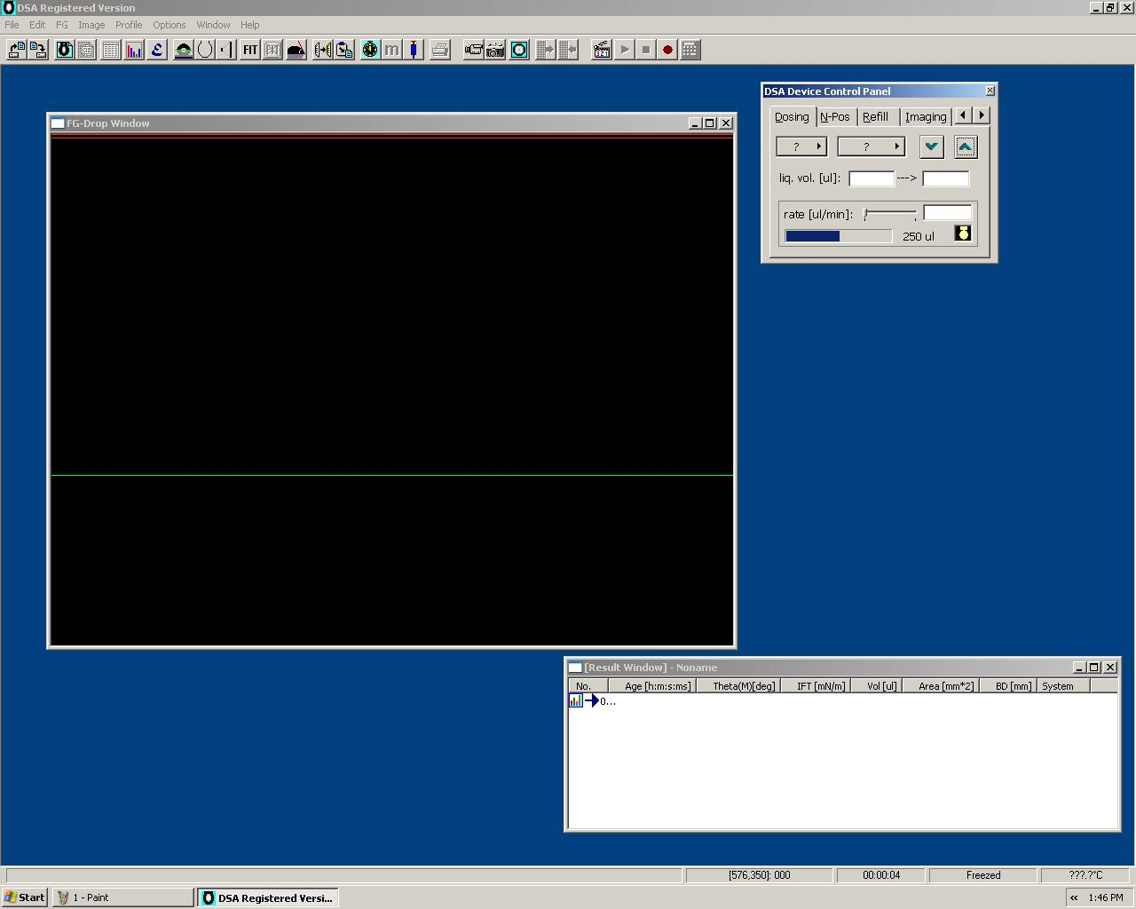
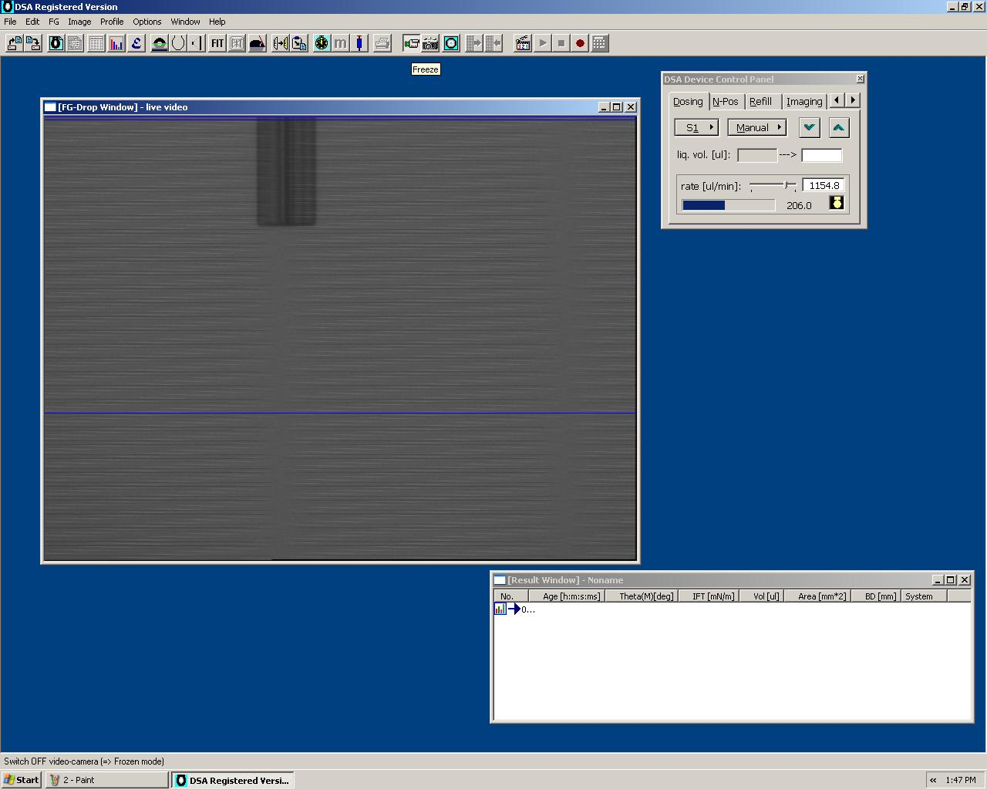
Click “video” button

Slide 4
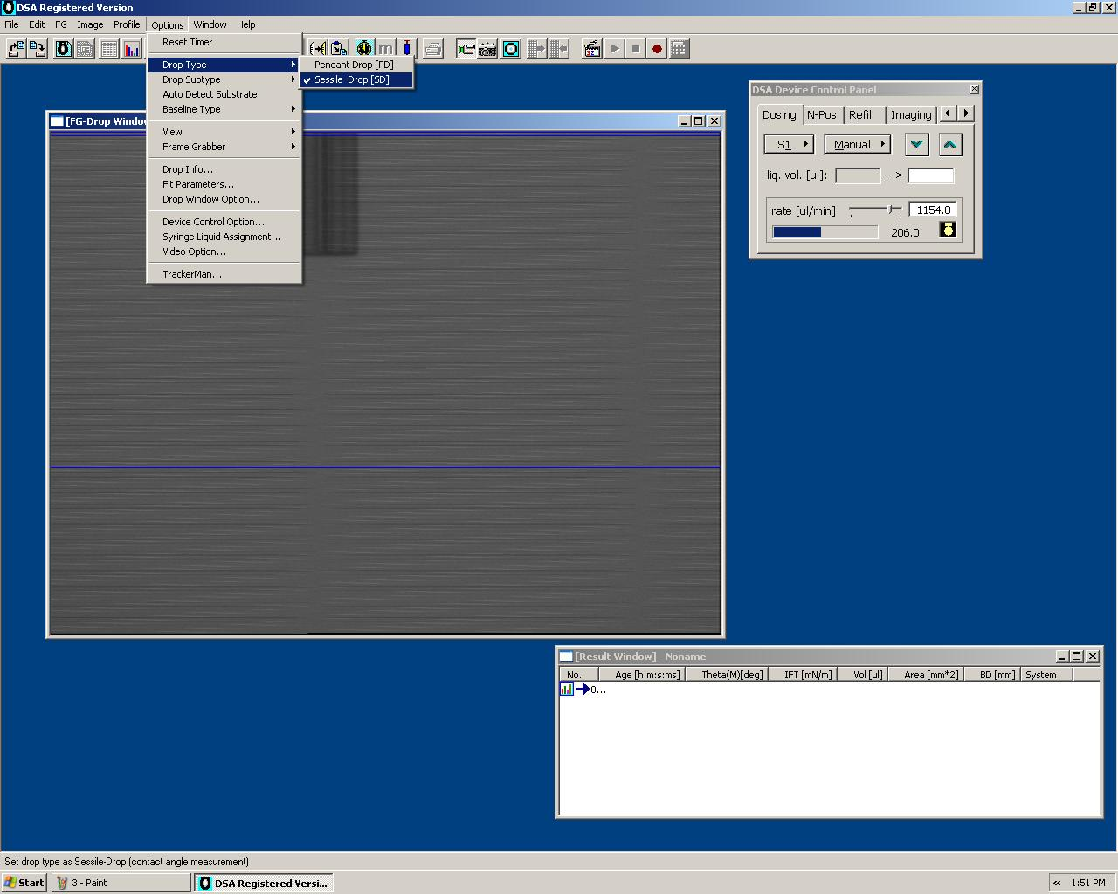
Click “Options”
Select “Drop Type”
Choose “Sessile Drop”

Slide 5
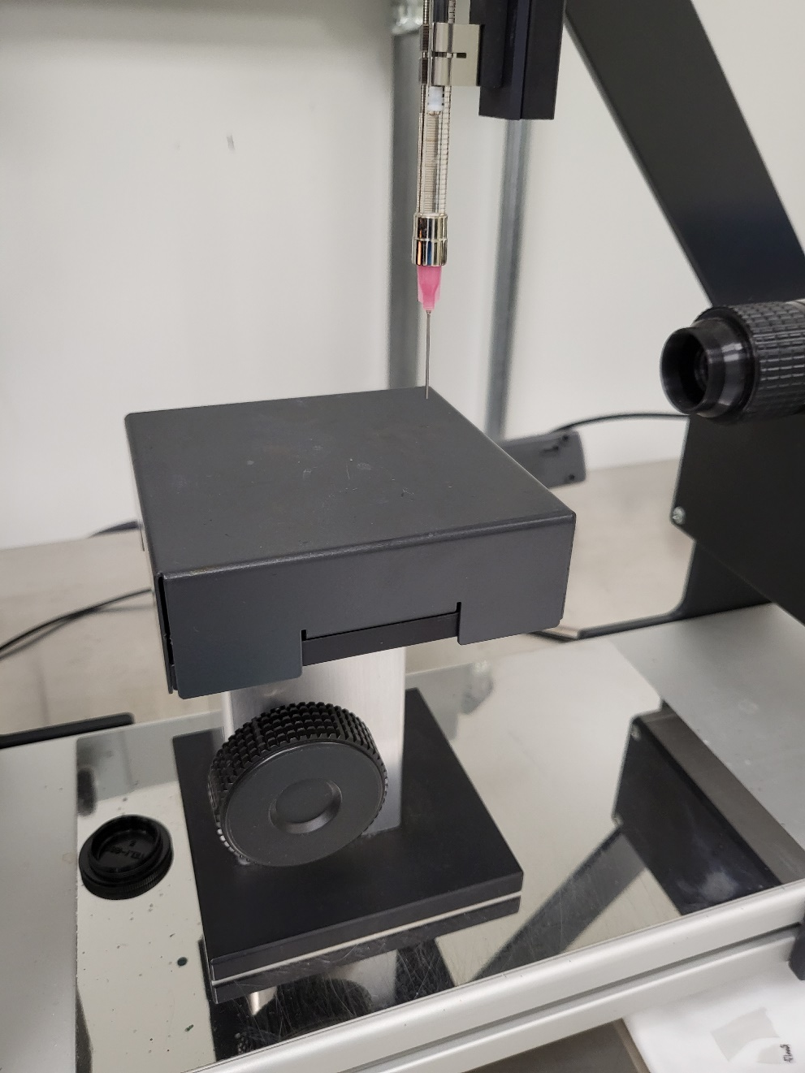
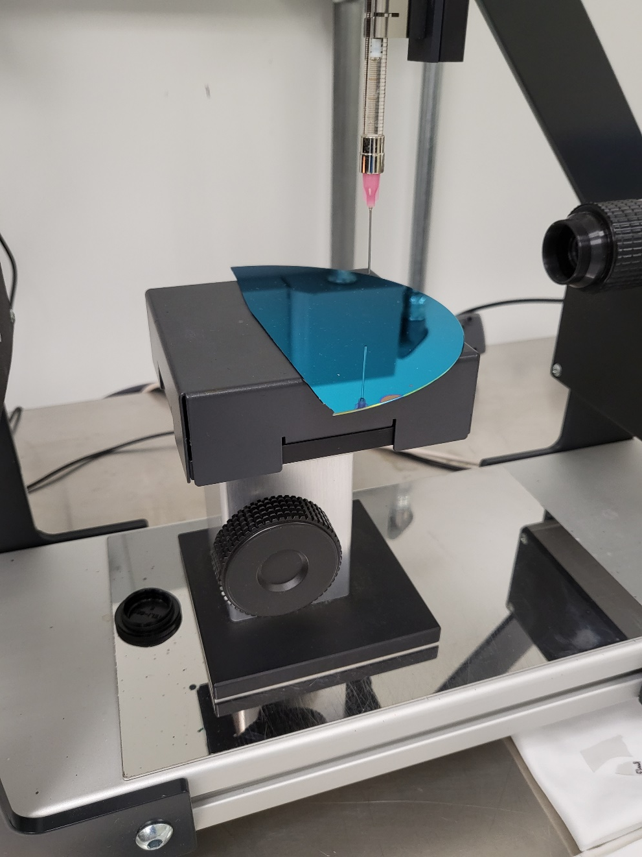
Stage up to load a substrate
Load the sample
Stage up the sample close to the needle (do not touch the needle with the sample)
Stage down
Stage up

Slide 6
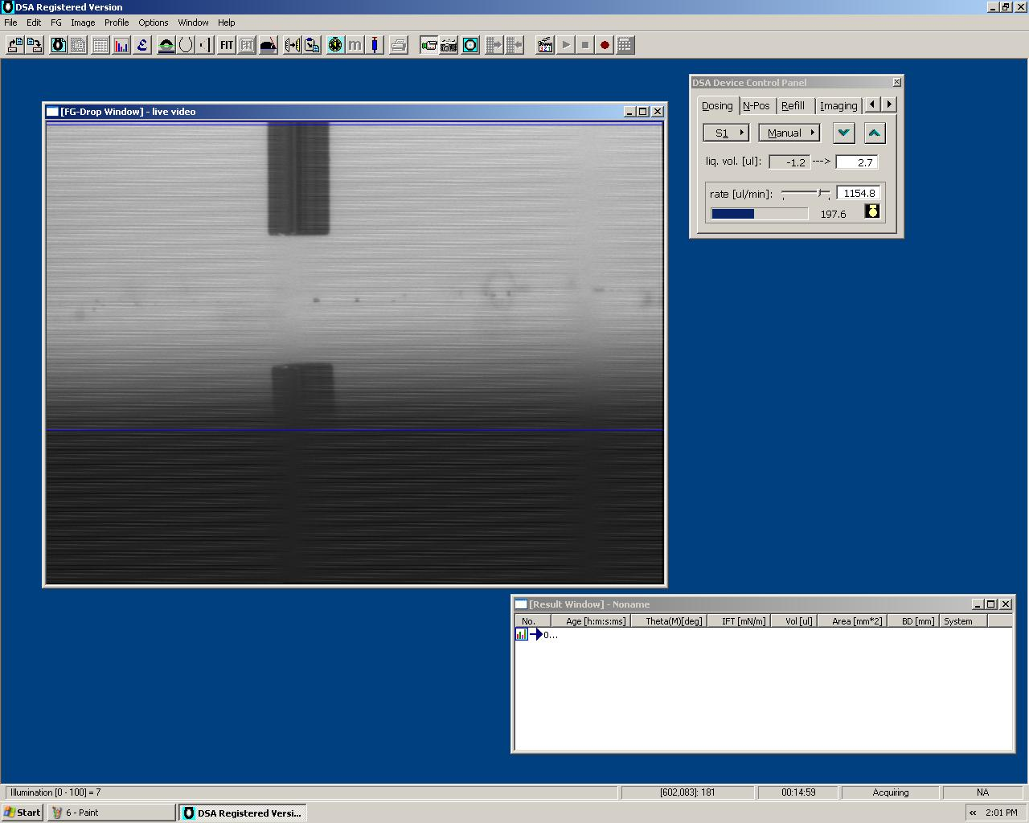
Stage up the sample close to the needle
Move the stage until it is just below the sample
Adjust the camera focus so that the edges of the needle are as sharp as possible.
boundary of the top surface

Slide 7
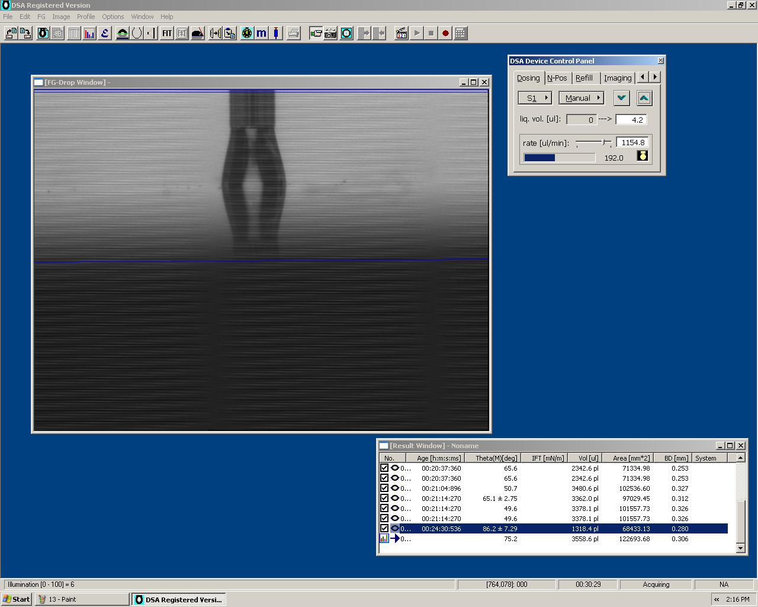
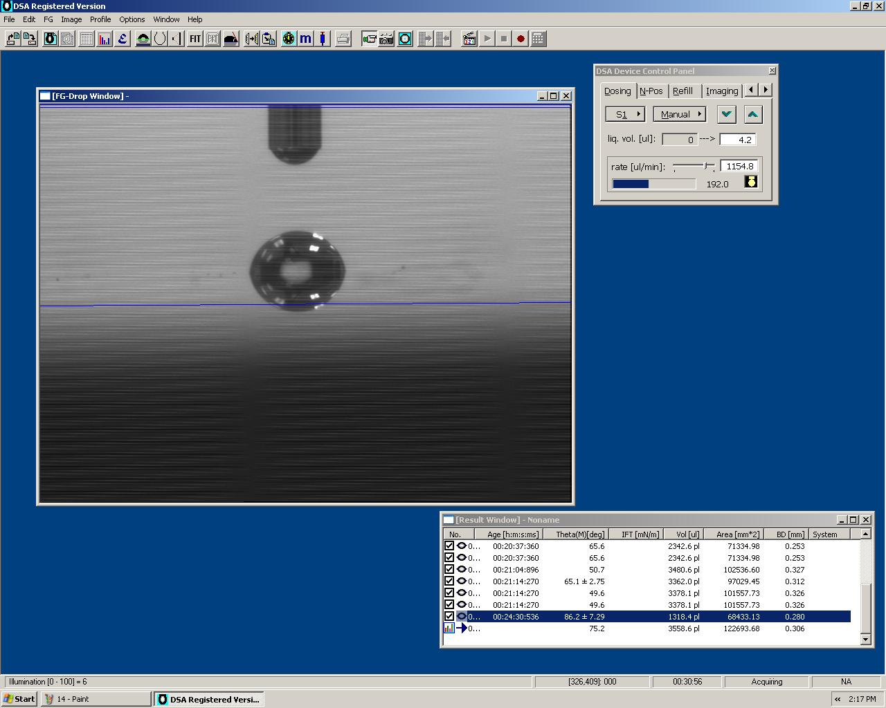
Click the “arrow up” button to increase a water drop size
Stop deposition when it reaches the surface
Stage down to place the water drop in the middle

Slide 8
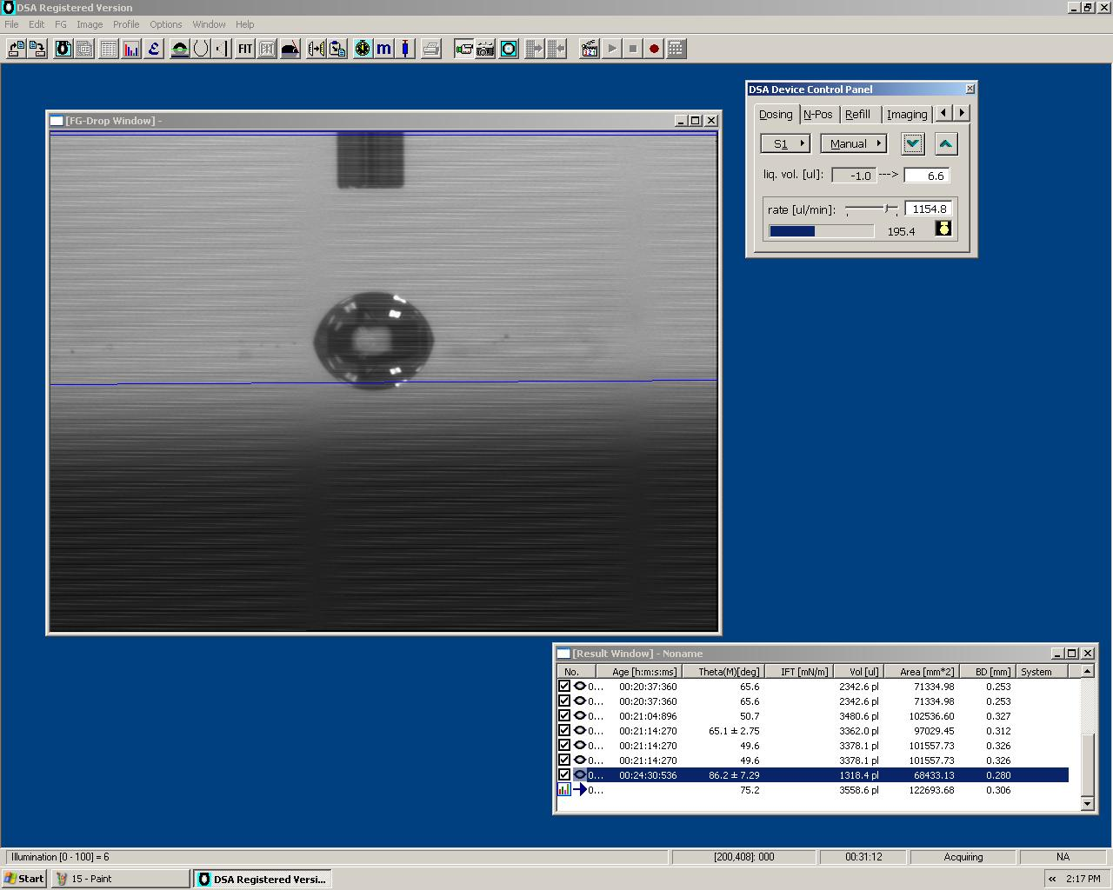
Click the “arrow down” button to remove the water drop at the end of the needle

Slide 9
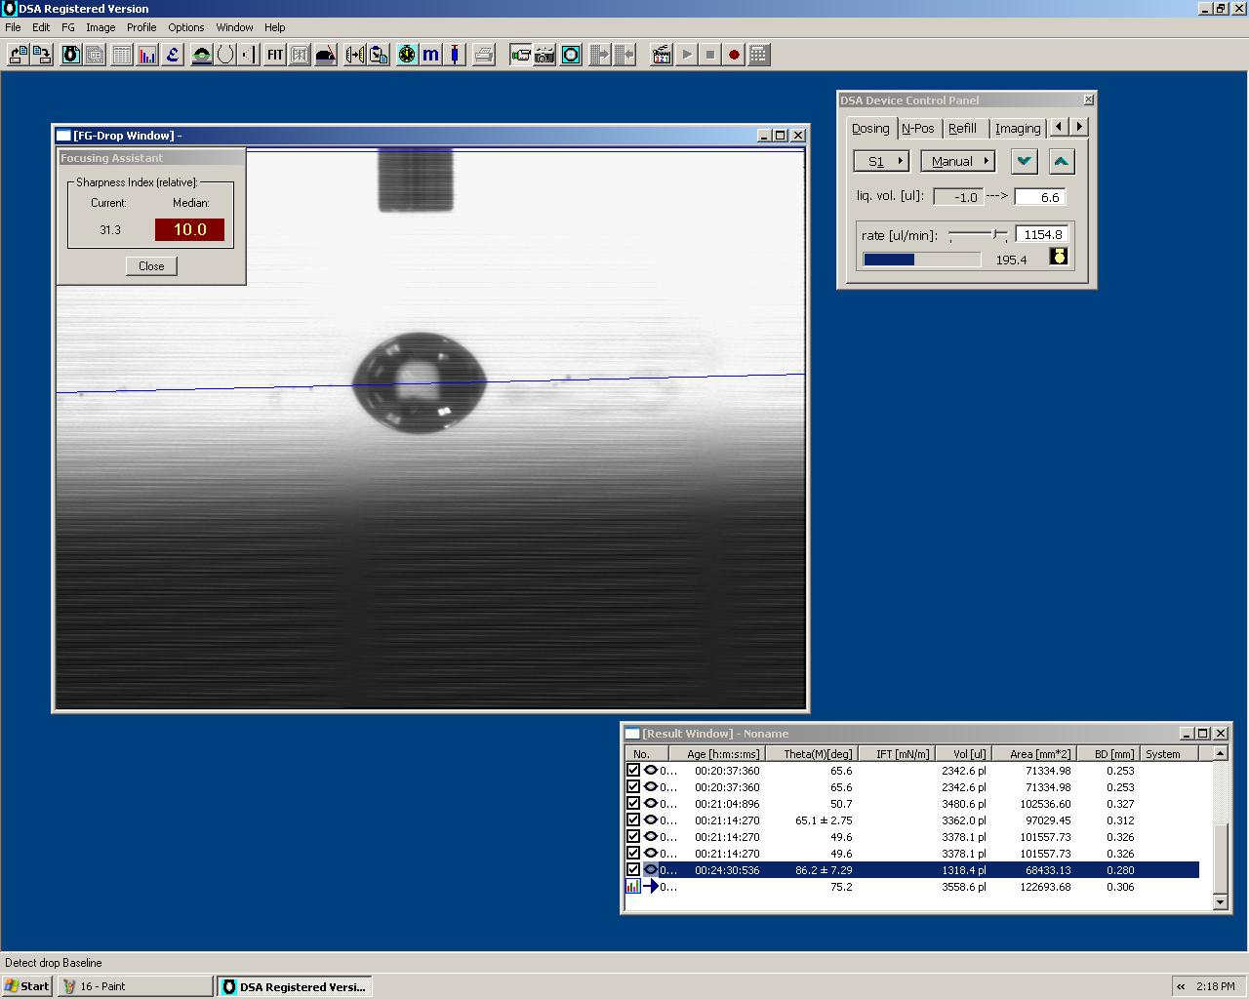
Click the “focusing assistant” button to increase video contrast (brightness) with the page up and down button
Click the “baseline” button in order to determine the baseline automatically
2
1

Slide 10
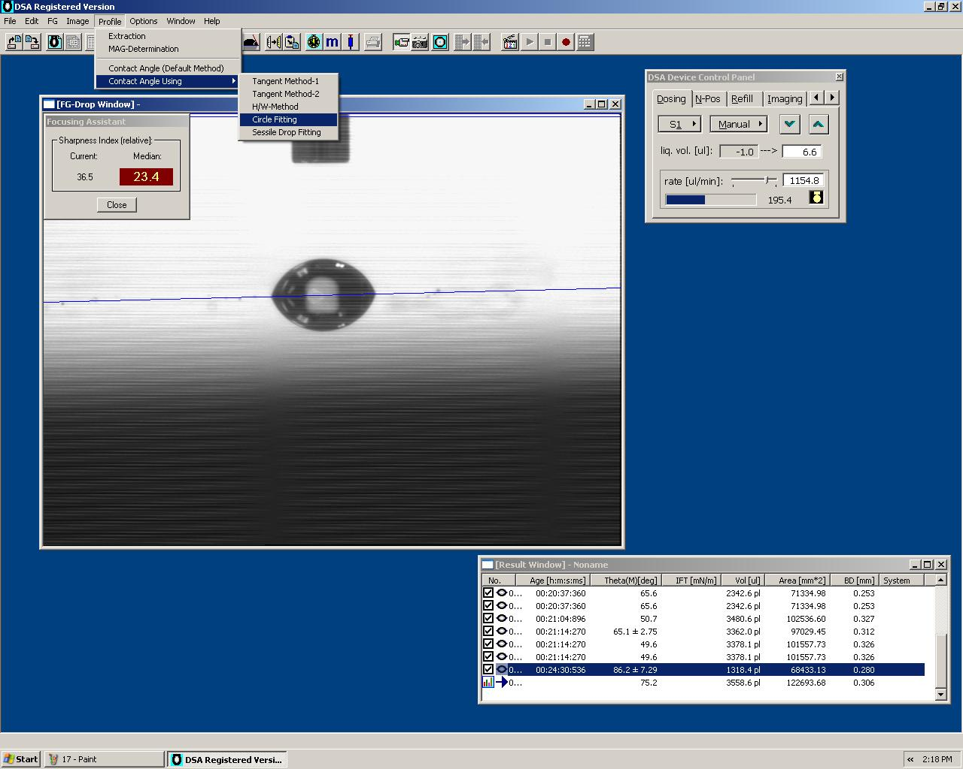
Click “Profile”
Select “Contact Angle Using”
Choose “Circle Fitting”
Check “Contact Angle”
Minimize the brightness with the page down button when your measurements are complete.
Close the software

