Slide 1
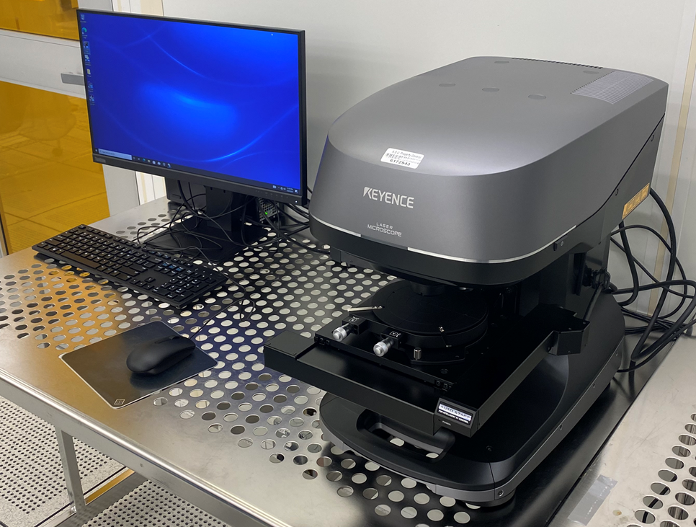
Keyence VK-X3000
3D Surface Profiler

Slide 2
Sample Measurement
Start the Viewer Application and turn on the power switch
Return the stage to the origin
Load sample
Perform initial focus of sample using the focusing handles
Use Viewer Application to increase magnification and measure the sample
Perform filtering on measured sample
Perform desired measurement techniques on measured sample
Perform another measurement or shut down the profiler

Slide 3
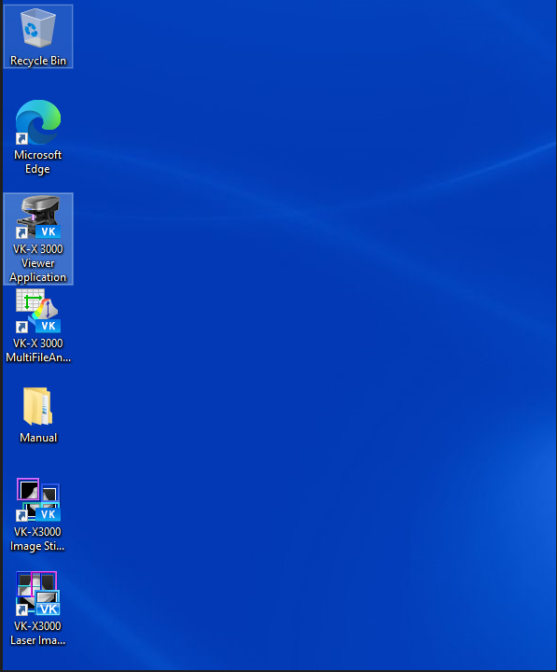
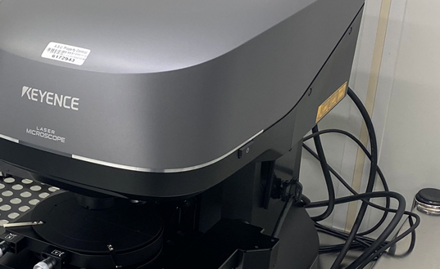
1. Start the Viewer Application and turn on the power switch
2
1
Open the application first
Once the application is open, press the power button. You can not turn on power unless the application is open.

Slide 4
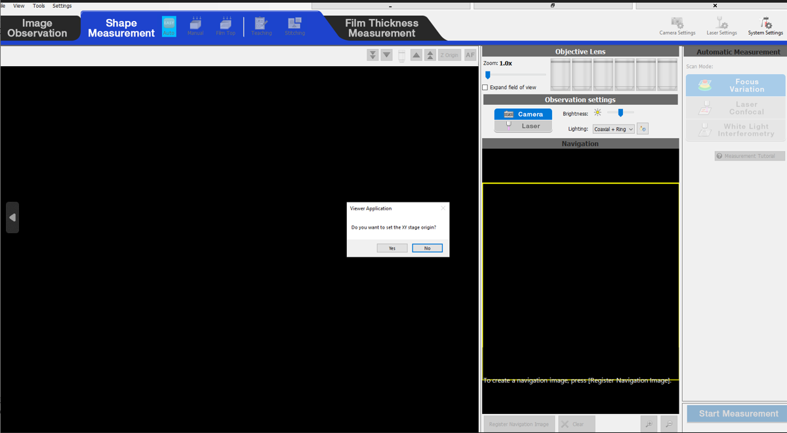
2. Return stage to the origin
Once the power is on, you will be prompted to rehome the origin, select ‘Yes’
The light will also illuminate once the power is on

Slide 5
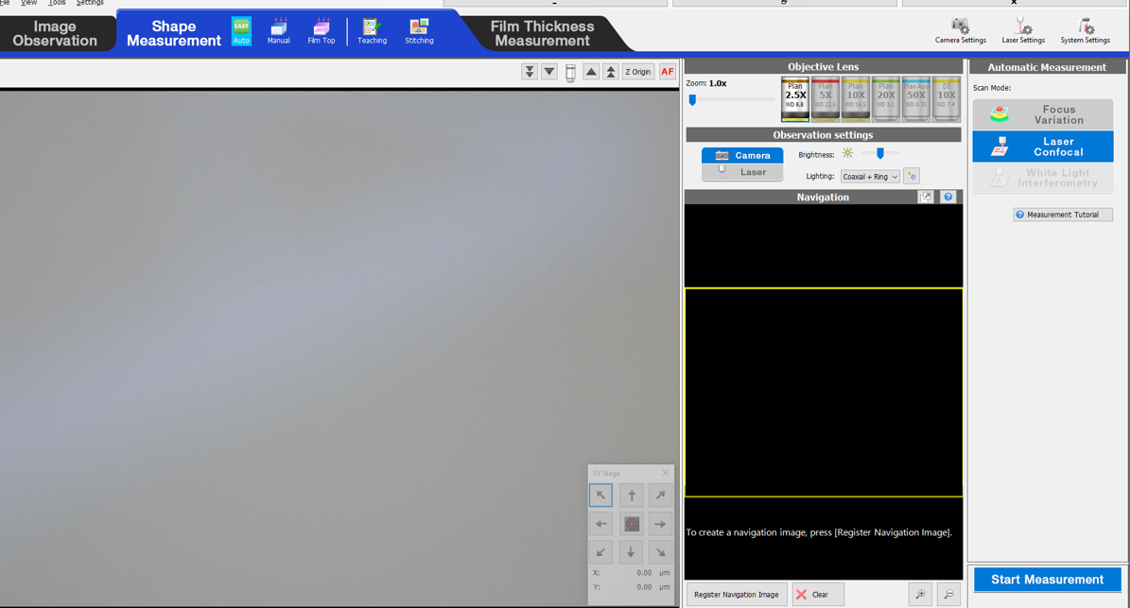
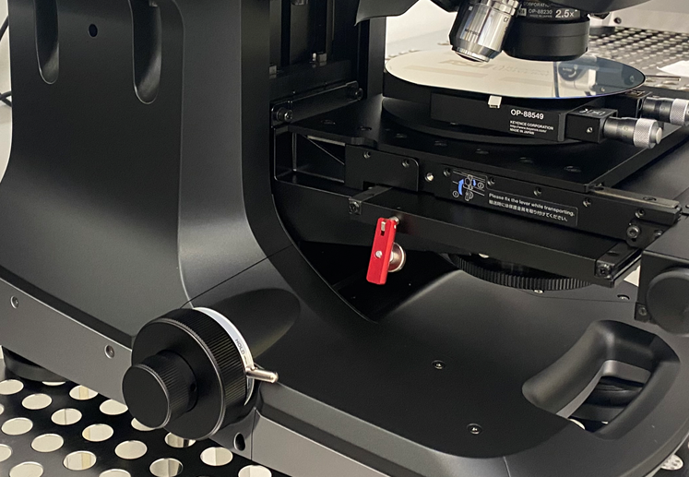
3. Load Sample
Verify that the 2.5X Objective lens is selected
Ensure that sample can be loaded safely without touching the lens
If the distance from the state to the lens needs to be increased to safely load a sample, use manual stage height adjust to increase the distance. Place the selector in the unlocked position to manually turn the wheel.
The XY stage can accommodate samples up to 70mm in height and 3.0kg in weight.
Coarse
Fine
Unlocked Position

Slide 6
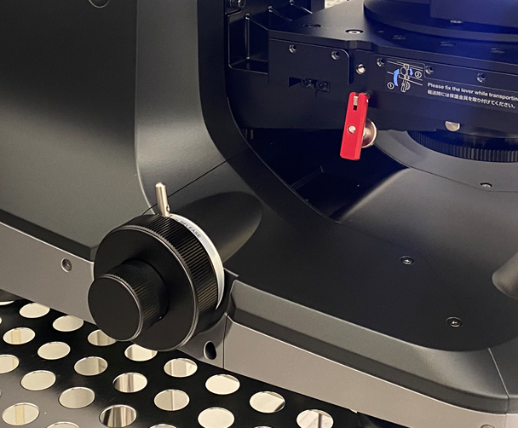
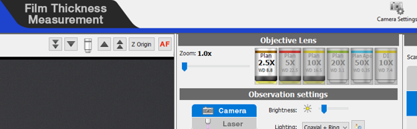
4. Perform initial focus of sample using the focusing handles
With the focusing lock still in the unlocked position, use the Coarse and Fine adjustment knobs to bring the sample into focus using the 2.5X lens.
Once the sample is in focus, move the locking mechanism to the locked position
Press the Auto Focus button to allow the system to optimize focus.
Coarse
Fine
Unlocked Position
Locked position

Slide 7
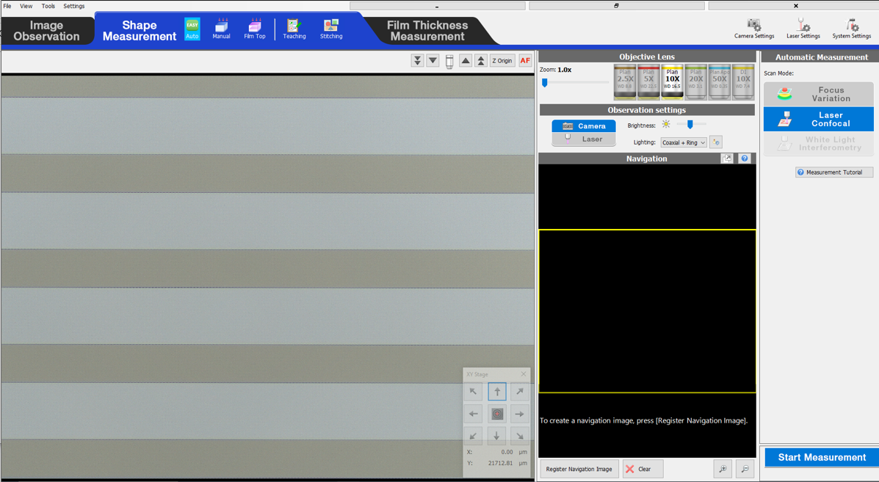
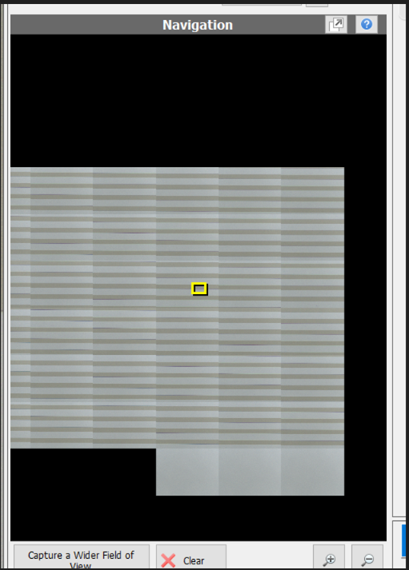
5. Use Application to increase magnification and measure the sample
Increase the objective lens one by one performing an auto focus with each lens
You can create a navigation image which will stitch together multiple images to aid in driving to an area of interest.
  Press the “Register Navigation Image” to start this, you can let if complete or stop it once you are satisfied with the area sampled.
Once the 50X lens is selected, and your desired area is in focus, press the “Start Measurement” button.
Once the “Start Measurement” button is pressed, do not vibrate the table. When complete the Analyzer software will automatically launch.

Slide 8
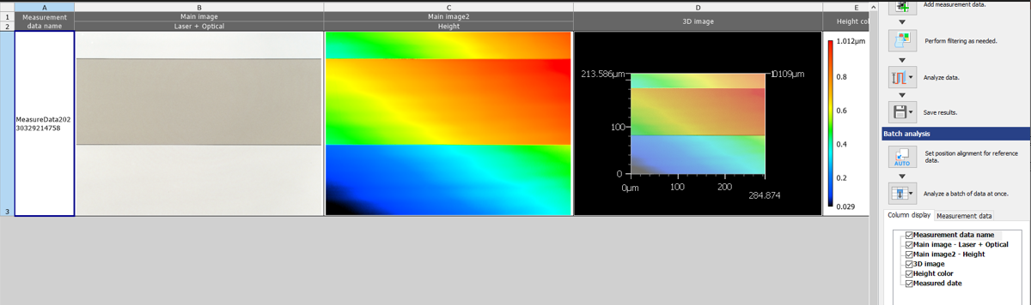
6. Perform filtering on measured sample
When the analyzer software launches, you will see several images displayed in the main data folder
Press the “Perform filtering as needed” button to level out the sample

Slide 9
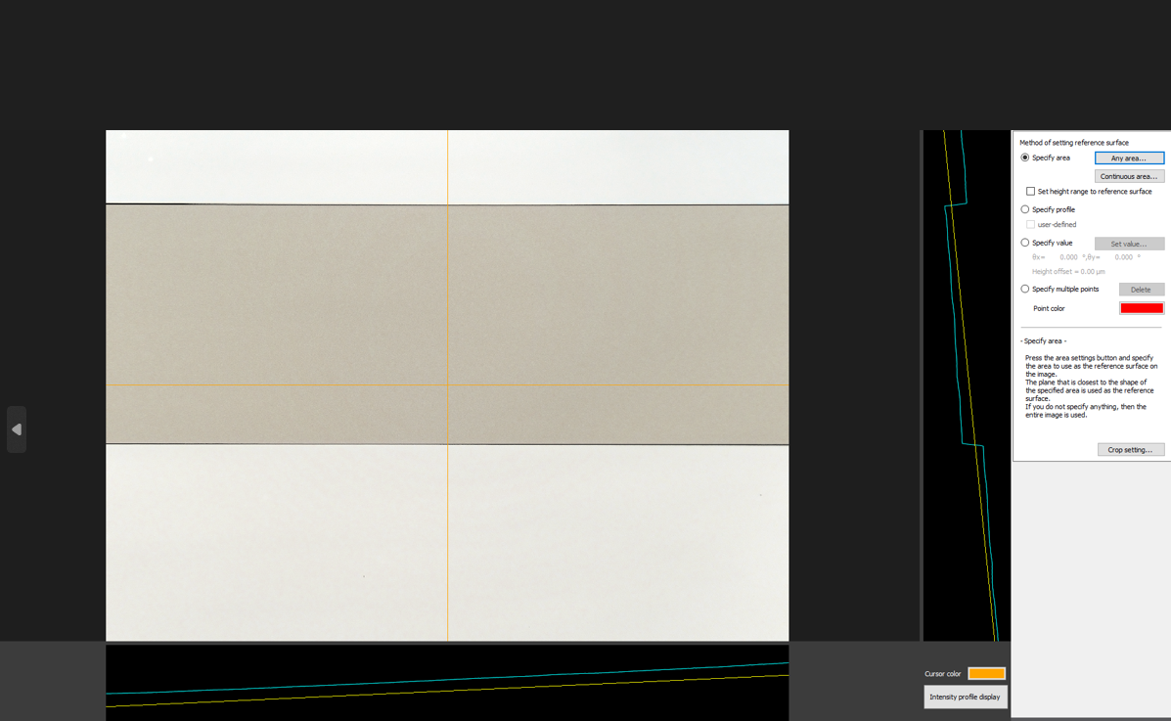
6. Perform filtering on measured sample (continued)
In this example any area has been selected to level out the sample and the initial screen is displayed here
I know that the two surfaces highlighted with red arrows are level with each other, so I will specify an area in one of these sections and verify that the displayed yellow line is flat with the blue profile in these areas

Slide 10
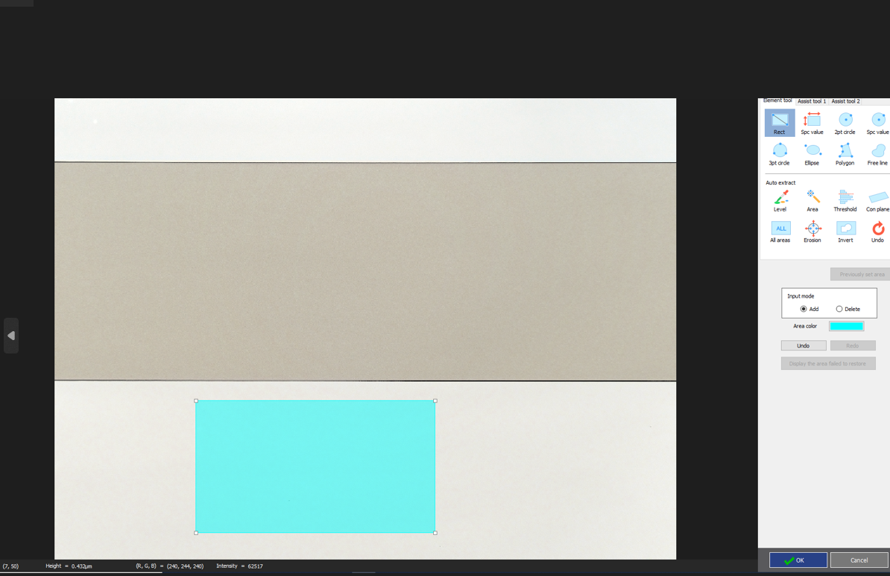
6. Perform filtering on measured sample (continued)
Area selected to perform leveling

Slide 11
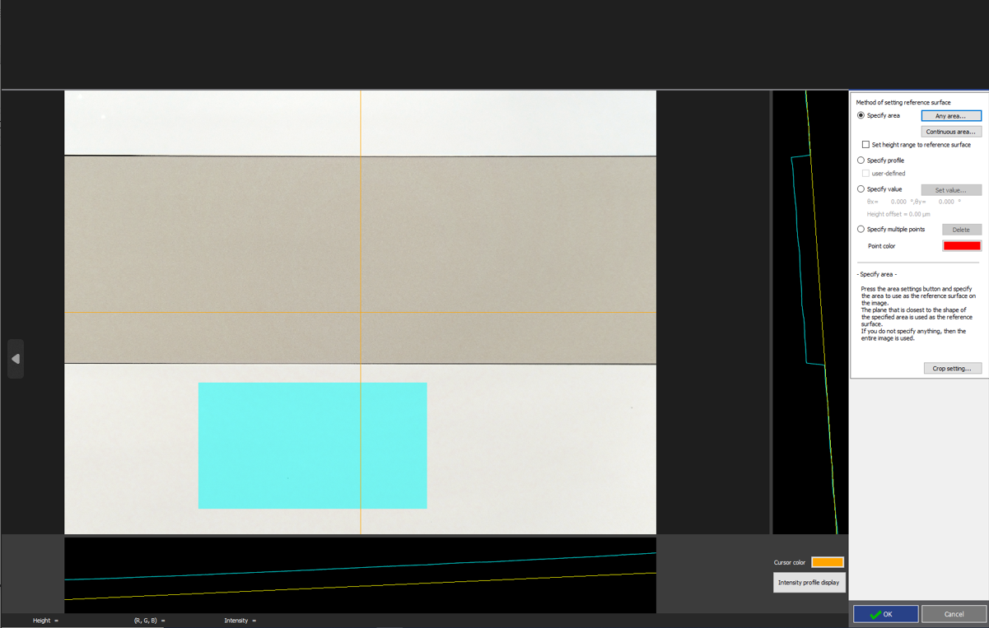
6. Perform filtering on measured sample (continued)
Result of leveling based on the area selected. Note that the yellow line is aligned to the blue profile in these two areas.
Depending on sample, may need to try other options to level best fit for your needs
Once satisfied with the level press “OK” and then “OK” again.

Slide 12
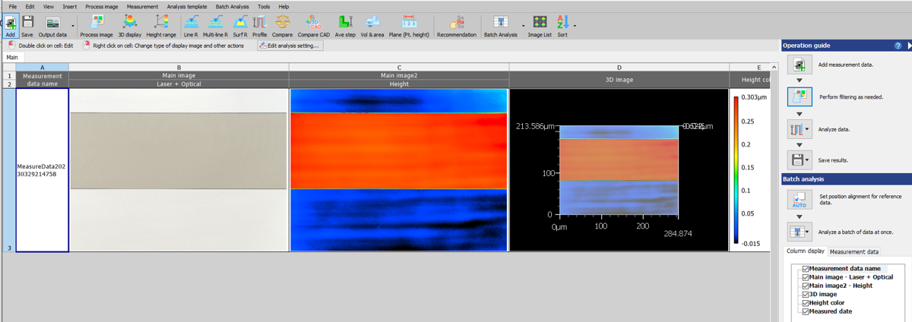
6. Perform filtering on measured sample (continued)
Now when you return to the Main screen, the measurement should be filtered

Slide 13
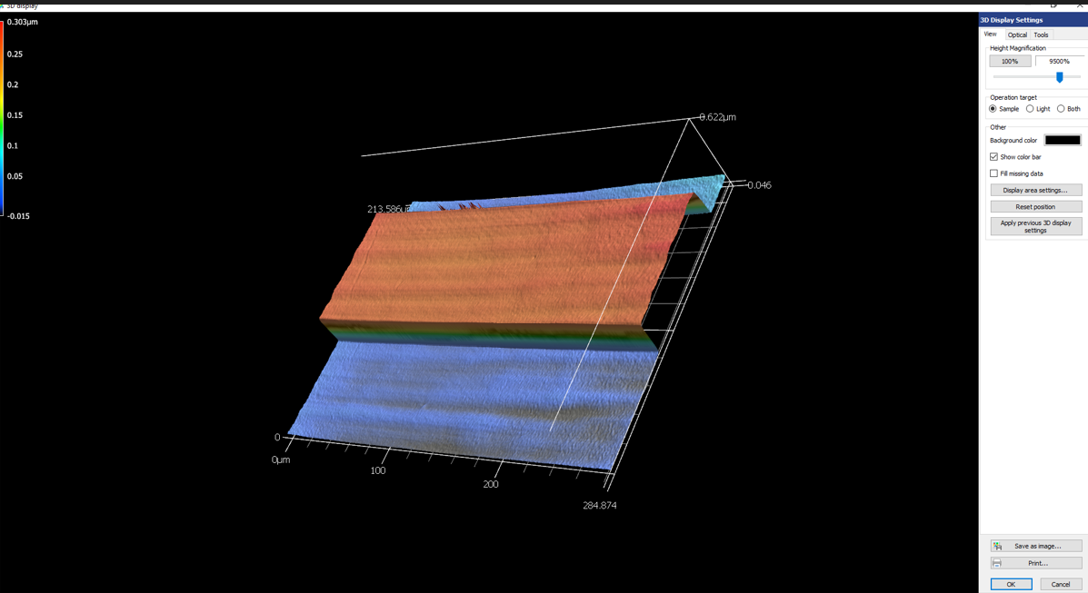
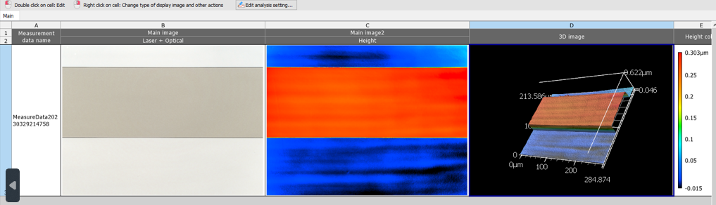
6. Perform filtering on measured sample (continued)
You can double click on the images and reorient and change the settings as desired.

Slide 14
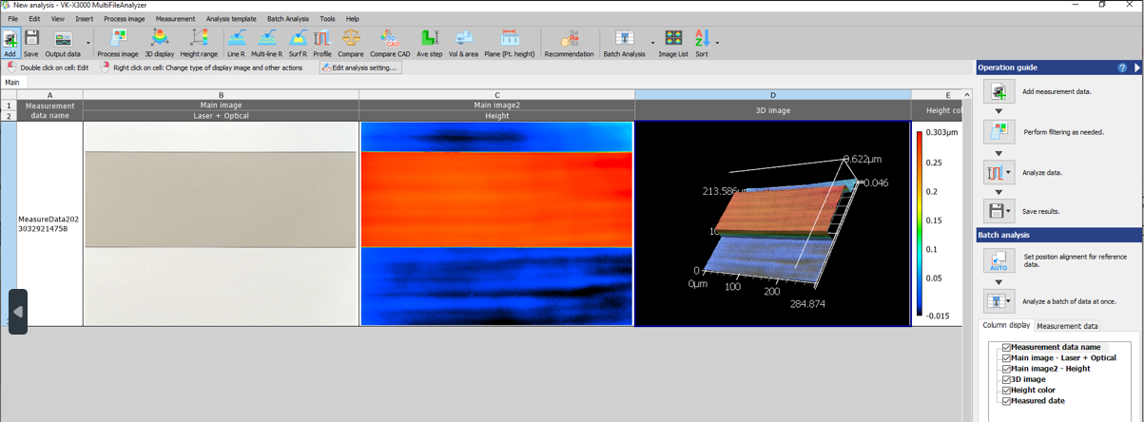
7. Perform desired measurement techniques on measured sample
Press the “Analyze Data” button from Main screen, or select the measurement type across the top off the screen, two options to get to the same place. In the next slide I’ve selected the Profile tool.

Slide 15
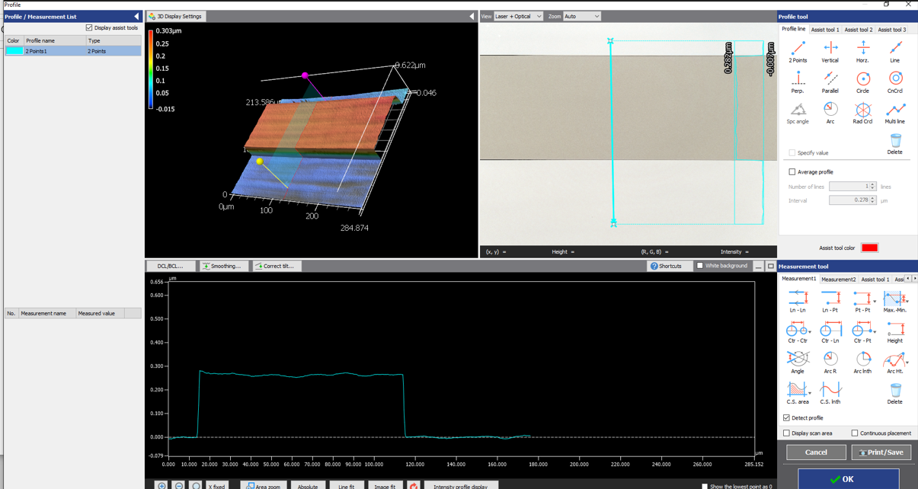
7. Perform desired measurement techniques on measured sample (cont)
For this Profile measurement example, I selected “2 Points” to define the where I want the profile measurement taken
Once your line is selected use the lower “Measurement tool” screen to define where you want to measure the data (next slide)

Slide 16
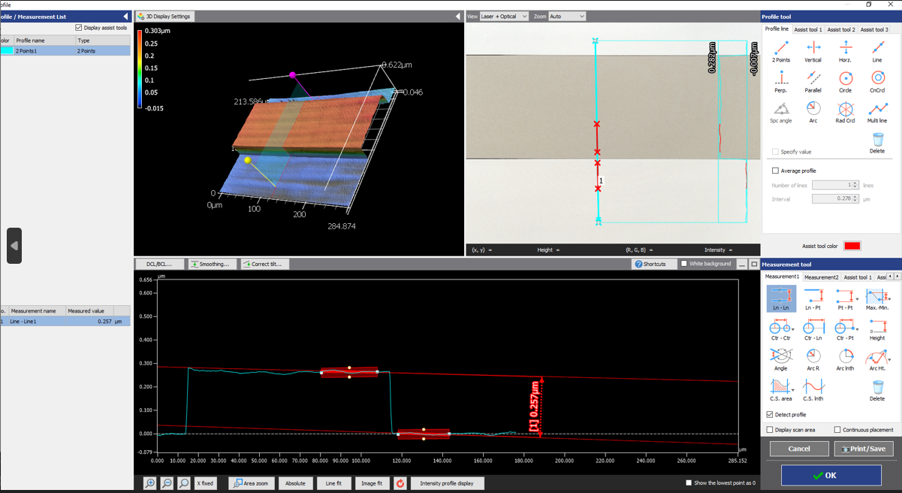
7. Perform desired measurement techniques on measured sample (cont)
The measurement tool selected here is “Ln-Ln”. When pressed you will define the start and end point for each line to be compared.
When complete the measured step height is displayed.
Press “OK” when complete to get to the next screen.

Slide 17
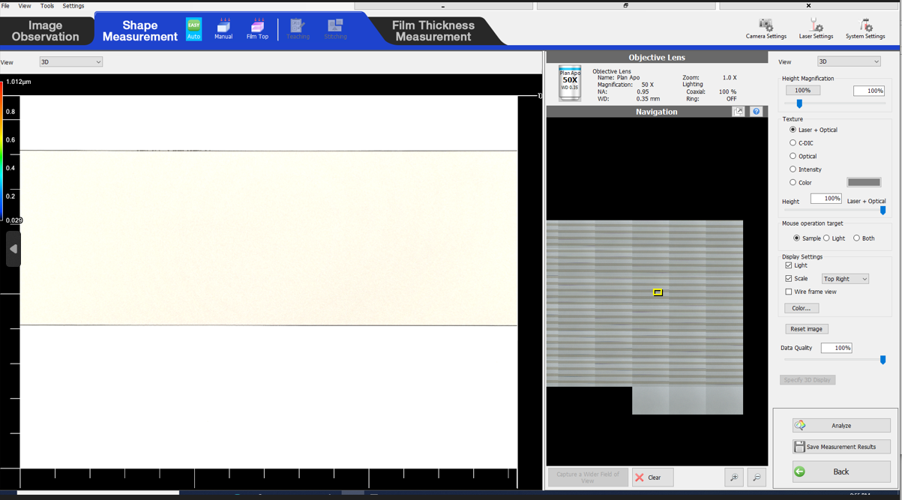
8. Perform another measurement or shut down the profiler
To perform a measurement on another area of interests, minimize the analysis window to return to the measurement window.
Press the back button

Slide 18
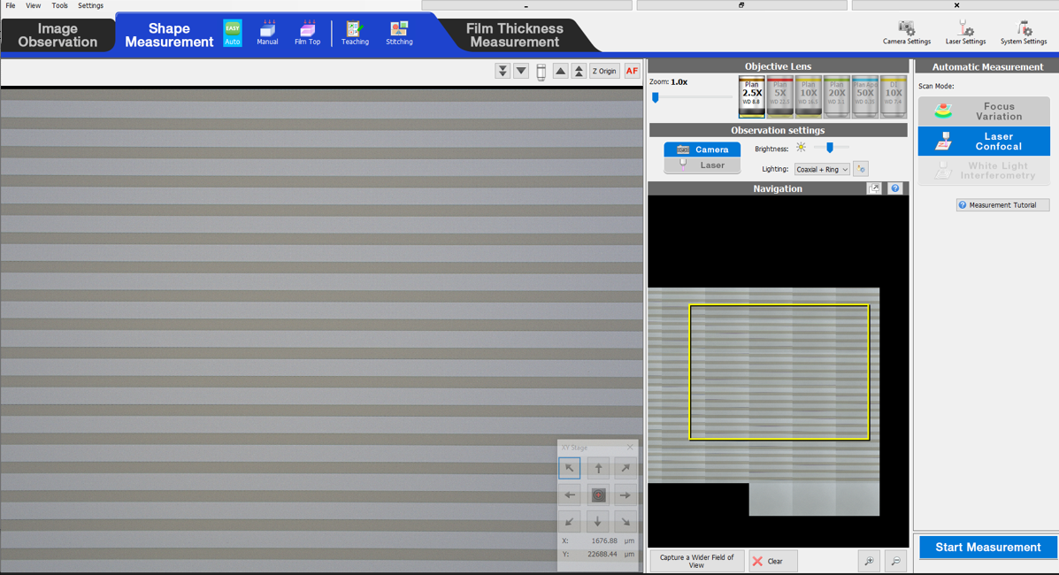
8. Perform another measurement or shut down the profiler (cont)
Once back in the measurement window, you can drive to another area with the arrow keys and repeat the steps to take a measurement.
If complete and ready to remove sample, change back the 2.5X Lens First.
Unlock the manual focus control level to lower the stage to remove sample.
If done with profiler:
  Close out the viewer application by pressing the x in the upper right corner
  Turn off the power on the right side of the profiler. The blue light in the front of the profiler should extinguish.

